Slide 1
Paper outline – ppt presentation mode
We will show the outline we have for the paper, and then all figures and tables section by section
Ultimatetly, our research shows Comamonadaceae is overly present in lists of ASVs that were defined as relevant by different methods. This is consistent across plant species and plant compartments
One of the reasons Comamonadaceae can be important is because they are also present and functional in the gut of herbivorous insects. Our research helps to blur the (artificial) line that divides plant microbiome from insect microbiome, while focusing new efforts in a specific group of microbes.
We would like your opinion on whether we place some figures as supplementary or main

Slide 2
Essential paper outline
Introduction
plant-insect-microbe interaction
Holobiont
data deluge
Methodology
Partially written, repository gets published/open
1 figure showing the experimental design [MAIN]
1 simplified fluxogram figure showing analysis steps [SUP]
Results
Plant growth & qPCR (show plants were stressed)
1 figure with 4 pannels, raw plant biomass values [MAIN]
1 figure, Cohen’s D effect size across pecies and variables [ SUP]
1 figure with 4 panels, qPCR plots [ SUP]
Beta & alpha diversity (Basic analysis present in any paper)
1 Figure, rarefaction curve [SUP]
1 Figure, full community beta diversity [MAIN]
3 tables, PERMANOVAs and pairwise comparison [3 SUP]
1 figure, full community Shannon diversity [MAIN]
2 tables, ANOVA and post-hoc [2 SUP]
Random forest (show ASVs that matter on prediction)
1 Figure with 4 panels, ASV abundance per treatment [SUP]
3 tables: sample size + precision + kappa, confusion matrix, ASV taxonomies [3 SUP]
Network analysis (describe networks, ASVs with importance tags, Leave module discussion on supplementary text)
1 figure with 4 panels showing the networks [SUP]
1 table showing differences to 1000 random networks [SUP]
1 figure showing PCA of network metrics [SUP]
1 figure with 4 panels showing module correlation to metadata [SUP]
Differential abundance (keep very short)
1 Fig, bi-plot heatmap [SUP ]
Fisher Summary (describe figure, highlight comamonadaceae)
1 figure with 4 pannels, showing fisher results on tree [MAIN]
Neutral models [3 figures, 2 sup tables]:
1 Figure of above-selected ASBs in a venn diagram[MAIN]
1 Scheme figure of data partitions, neutral modeling, ASV selection, and re-joining [SUP]
1 Figure of histogram of 100 PERMANOVA results, compared to full dataset and above-selected[MAIN]
1 figure ordinations of above-selected and full community [PROVISORY, SUP]
1 Figure with 4 panels: As- and Below-expected NMDrS[SUP]
2 tables, PERMANOVA table and pairwise comparisons [2 SUP]
1 table, 100 PERMANOVAs bootstrapping to Check artifacts [SUP]
Alpha diversity regression (focus on comamonadaceae)
3 figures with 6 pannels each (observed, Shannon and simpson diversty at Family, Order, and Class level for BO and AT) [3 SUP]
Above-expected differential abudances (heat tree focus on comamonadaceae)
1 figure with 2 pannels, has complex matrix of heat trees [MAIN]
Discussion
Methyl Jasmonate triggers plant defense
Validate Experimental approach
MeJA impacts the microbial community similarly to Oral Secretion, thus MeJA can be used in place of real insects
Show methodological variation on MeJA applications (foliar spray and sealed chamber)
Stress treatments were subtle on the structure of the full community but clear on the taxa occuring above neutraility
Advantages Methodological approach on neutral models
Compare base alpha and beta diversity to other references
the neutral spliting-and-joining can help see subtle treatment effects ;
the neutral tree can help locate a diversity hotspot (mention rhizobiales but limit discussion)
“Fishing” with Fisher: 1 out of 1.111 taxa highlighted by 3 different methods
Show how the excess of information complicates analysis
Show that after using several methods we still have a complex dataset
the fisher test in a heat tree helps summarizing findings (approach to data deluge)
Family Commonadaceae was relevant across treatments, plant species, sample types, and analysis methods
show that comamonadaceae was highlighted independently in both approaches
Show how common they are on the roots
Show how common they are in the insect gut
Fit them in the holobiont approach (insects do more than giving a ride to Bac)
CONCLUSION:
Comamonadaceae are important in insect-plant interactions

Slide 3
Introduction
Not started yet!
Give the basic overview of plant-insect-mirobe interaction
Frame it in the concept of the holobiont, groups of microbes
Show how the excess of information can hinder analysis and decisions (data deluge)
Maybe compare tools and targets of old microbiome research with new microbiome research because…
Old methods (differential abundance, alpha/beta diversity) do not account for group of ASVs (like in RF or networks).
Most references stop at differential abundance, while ASV prevalence in multiple samples, network degree, prediction importance can be largely independent of number of sequences
Popularization of code-based analysis favors development of new pipelines

Slide 4
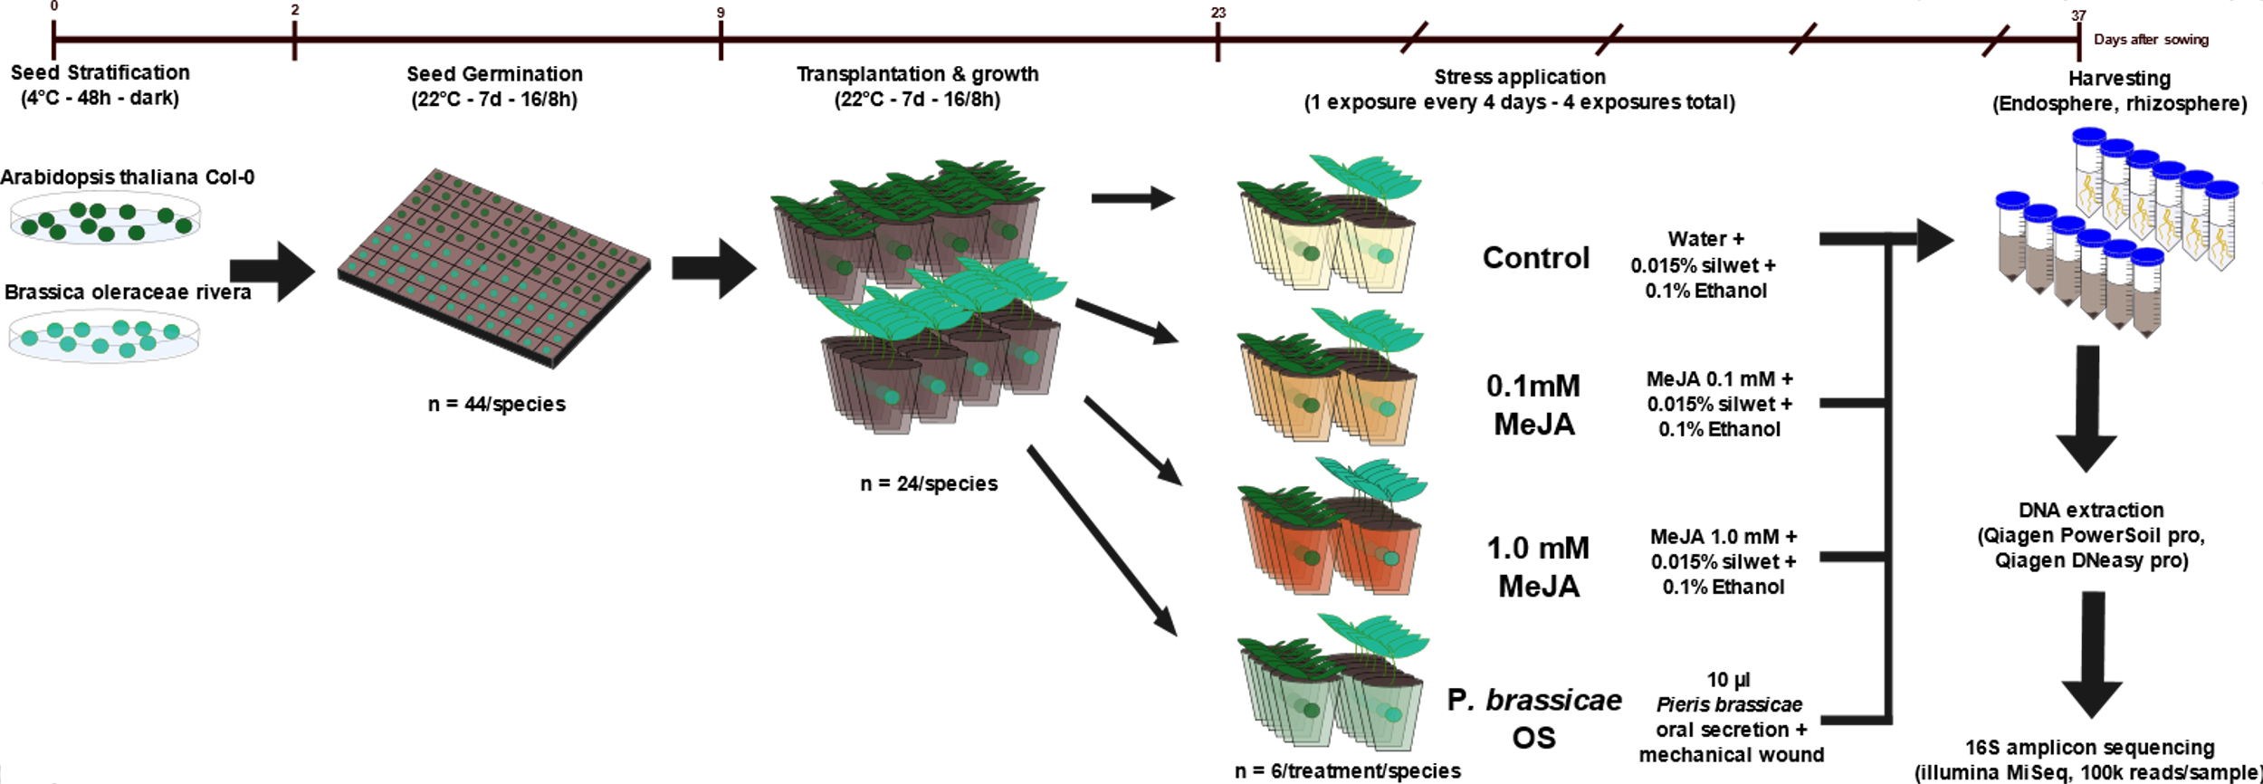
Methodology
Figure X. Experimental set-up and timeline of the experiment [MAIN]. Seeds of B. oleracea and A. thaliana were stratified, germinated and transplanted as individual plants to a standardized soil prior to exposure to three insect herbivory stress treatments over a 14-day period. Plants of each species (N=6) were either dipped four times in a solution containing 0.015% silwet + 0.1% ethanol plus either 0.1 or 1.0 mM of methyl jasmonate (MeJA), or wounded using a pattern wheel, followed by a 10-μl application of concentrated oral secretion from larval Pieris brassicae; six plants of each species were dipped in water + 0.015% silwet + 0.1% ethanol as a control. At harvest, 37 d after sowing, aboveground phenotypic traits were measured, and roots were processed for rhizosphere and endosphere 16S amplicon sequencing.

Slide 5
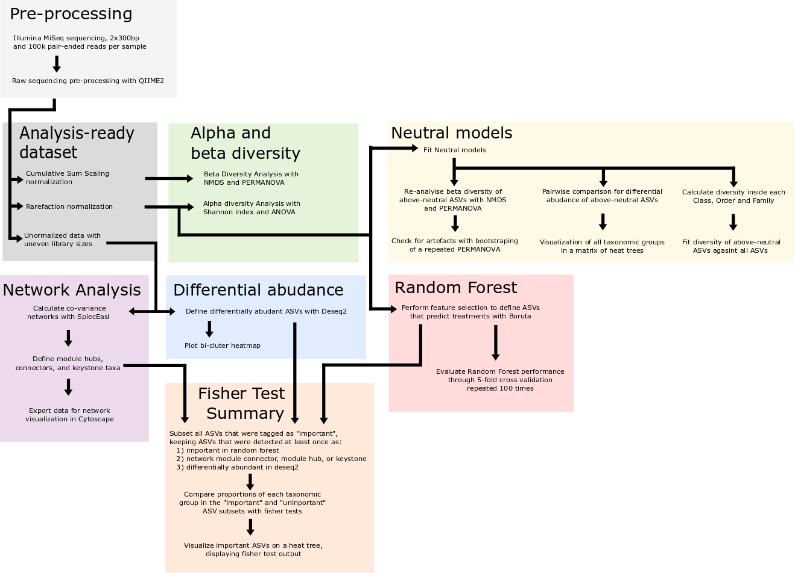
Methodology
Sup X. Simplified Fluxogram figure showing analysis steps [SUP]. Types of analysis and input data. A more complete version showing used functions, packages and code chucks is available on the GitHub repository

Slide 6
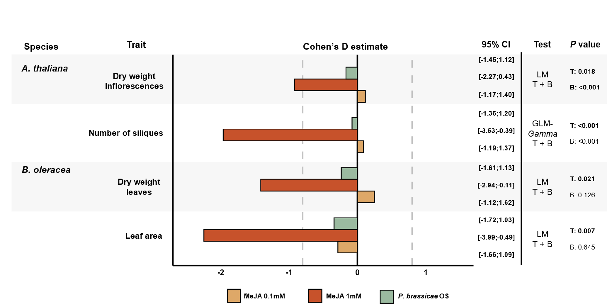
Results
Plant growth & qPCR (show plants were stressed)
1 figure, Cohen’s D effect size across species and variables [MAIN]
Cohen’s D to standardize plant responses based on controls and variation across replicates.
Calculated as the difference between experimental and control means divided by their pooled SD.
Positive or negative values indicate that the treatment values are larger or smaller than those in the control, respectively
Figure X. Forest plot of the effect size of traits measured for A. thaliana and B. oleracea in stress treatments compared to controls [MAIN]. Bars show Cohen’s D estimate value. Gray dashed-line indicates a value of 0.8, above which the effect size is considered large (Cohen et al., XXXX). Negative Cohen’s D values indicate that the trait measurement had lower values in stress-induced plants compared to controls, whereas positive values indicate that trait measurement values on stress-induced plants were higher than for controls.

Slide 7
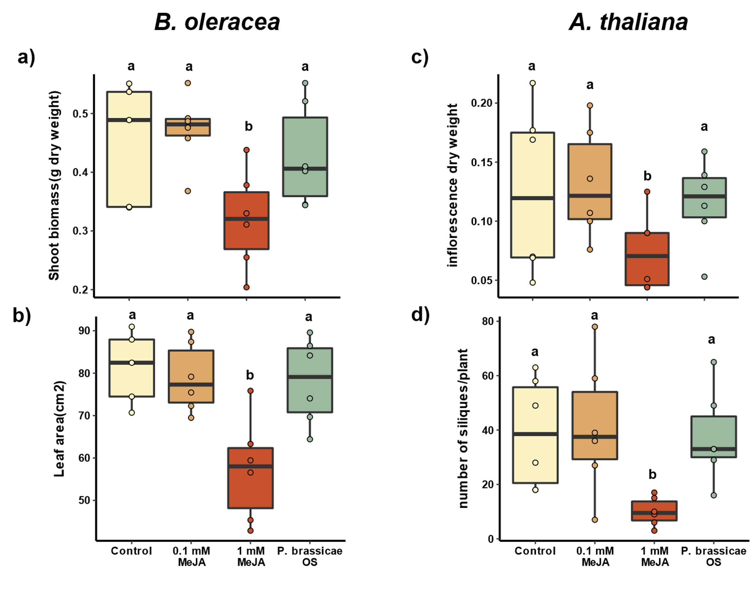
Results
Plant growth & qPCR (show that plants were stressed)
1 figure with 4 pannels, raw plant biomass values [SUP or MAIN?]
1 figure with 4 panels, qPCR plots [ SUP]
Figure X. Plant traits measured after 14 days of stress induction [SUP]. Boxplot height corresponds to the first and third quartiles, dark middle line to the median. Dots represent the raw measurement of one individual plant. N=5-6. Traits measured for Brassica oleracea were a) dry shoot biomass and b) leaf area. For Arabidopsis thaliana plants c) dry weight of inflorescences and d) total number of siliques per plant were measured. Different letters above boxplots show significant differences (One-way ANOVA, post hoc Tukey/GLM).

Slide 8
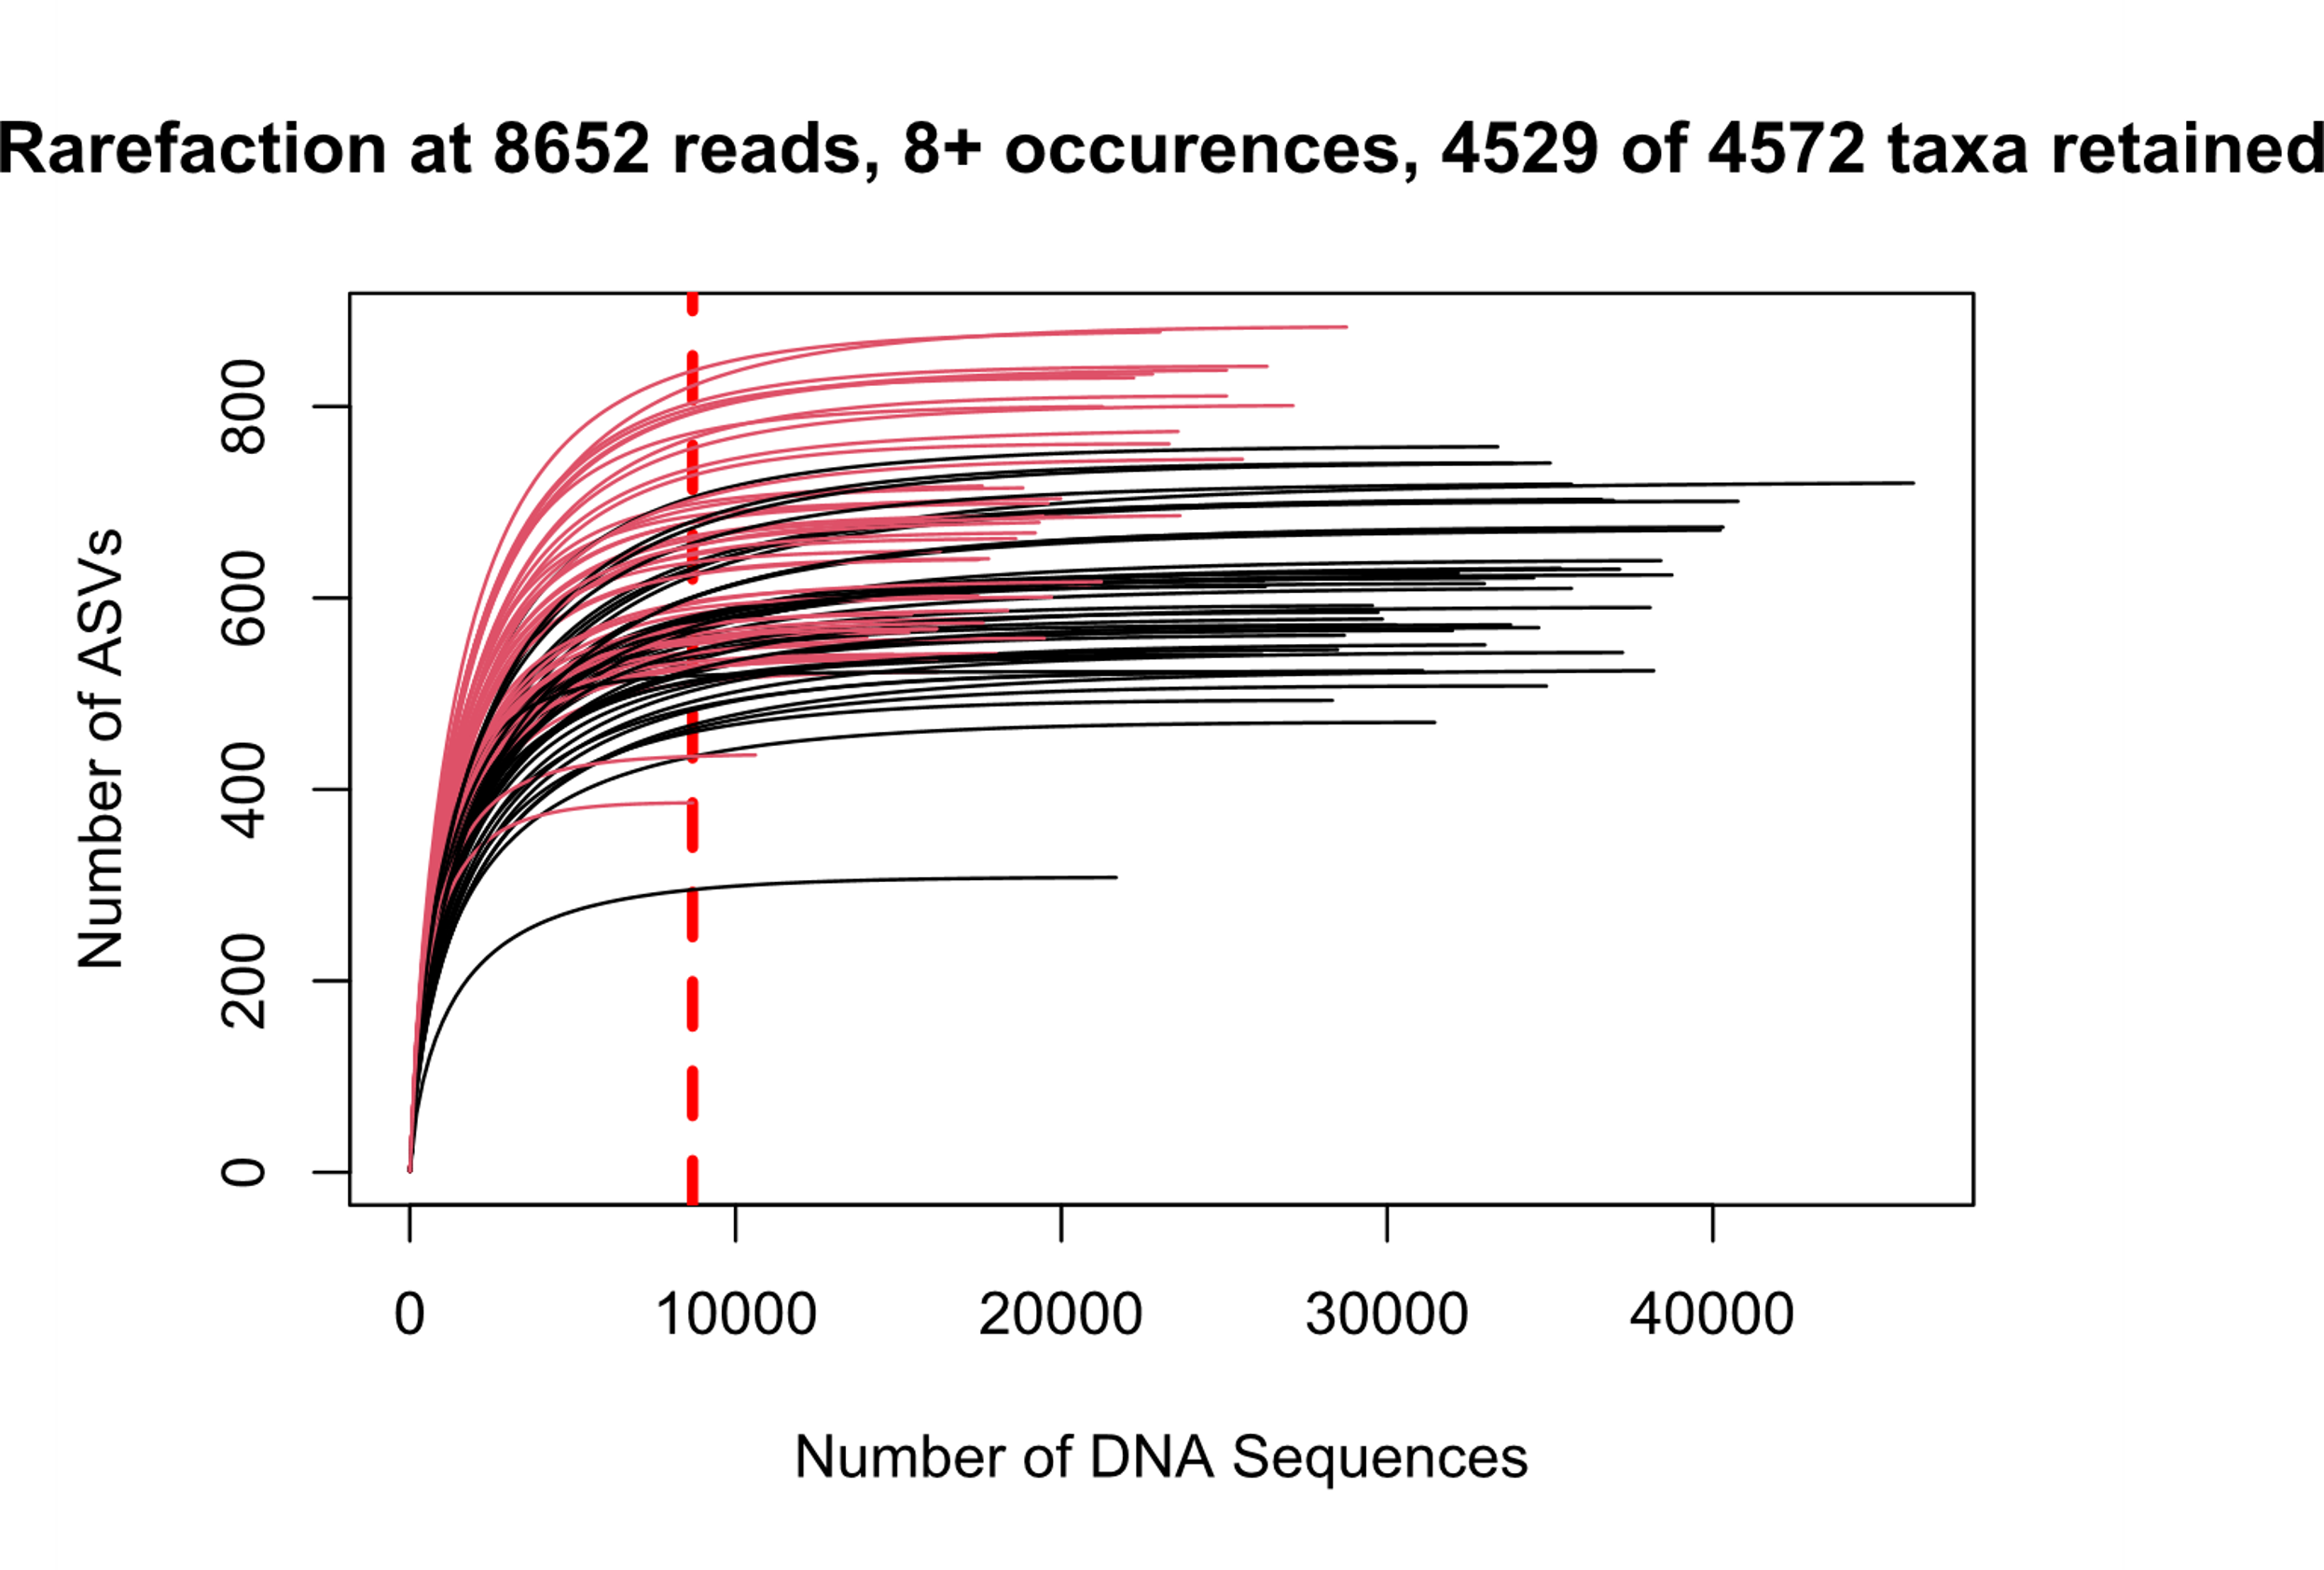
Results
Beta & alpha diversity (Basic analysis present in any paper)
1 Figure, rarefaction curve [SUP]
1 Figure, full community beta diversity [MAIN]
3 tables, PERMANOVAs and pairwise comparison [3 SUP]
1 figure, full community Shannon diversity [MAIN]
2 tables, ANOVA and post-hoc [2 SUP]
Sup X. Rarefaction curve [SUP]: rarefaction curve for filtered ASVs with minimum 9 ocurrences. Curved black lines represent endosphere samples and red lines represent rhizosphere samples. The dashed red line shows the minimum library size of 8652 ASVs

Slide 9
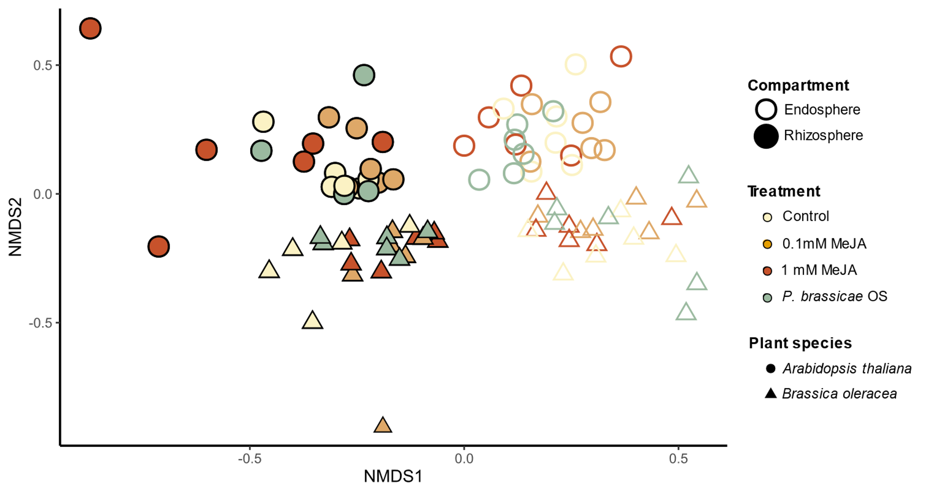
Results
Beta & alpha diversity (Basic analysis present in any paper)
1 Figure, full community beta diversity [MAIN]
Figure X. Bacterial community assembly across plant species, root compartment and treatments. [MAIN]. Non-metric multi-dimensional scaling (NMDS) plot based on Bray-Curtis distances showing clear clustering by plant species and sample types, and mixed treatment effects. Show PERMANOVA table values in the figure?

Slide 10
Results
Beta & alpha diversity (Basic analysis present in any paper)
3 tables, PERMANOVAs and pairwise comparison [3 SUP]
SUP_Permanova_table_a: PERMANOVA table of community composition including all ASVs of all samples. SumOfSqs = Sum of Squares, R2 = explained variance, Df = degrees of freedom, asterisks indicate significant differences
 | Df | SumOfSqs | R2 | F value | P value
Stress treatment | 3 | 0.4586 | 0.0362 | 1.6211 | 0.006 | **
Plant species | 1 | 1.2735 | 0.10051 | 13.5032 | 0.001 | ***
Sample type | 1 | 2.0913 | 0.16506 | 22.1755 | 0.001 | ***
Block | 5 | 0.8289 | 0.06542 | 1.7579 | 0.001 | ***
Stress treatment:Plant species | 3 | 0.5193 | 0.04098 | 1.8354 | 0.003 | **
Stress treatment:Sample type | 3 | 0.2254 | 0.01779 | 0.7968 | 0.906
Plant species:Sample type | 1 | 0.2616 | 0.02064 | 2.7734 | 0.001 | ***
Stress treatment:Plant species:Sample type | 3 | 0.2214 | 0.01747 | 0.7825 | 0.924
Residual | 72 | 6.7902 | 0.53592
Total | 92 | 12.6702 | 1

Slide 11
Results
Beta & alpha diversity (Basic analysis present in any paper)
3 tables, PERMANOVAs and pairwise comparison [3 SUP]
SUP_Permanova_table_b: PERMANOVA table of community composition including all ASVs of each sample partition. SumOfSqs = Sum of Squares, R2 = explained variance, Df = degrees of freedom, asterisks indicate significant differences
Plant species | Sample type | Effect | Df | SumOfSqs | R2 | F value | P value
A. thaliana | Endosphere | Stress treatment | 3 | 0.3774 | 0.1601 | 1.2018 | 0.0165 | *
 |  | Block | 5 | 0.6188 | 0.2625 | 1.1823 | 0.0171 | *
 |  | Residual | 13 | 1.3609 | 0.5773
 |  | Total | 21 | 2.3571 | 1
 | Rhizosphere | Stress treatment | 3 | 0.3210 | 0.1416 | 1.1673 | 0.0068 | **
 |  | Block | 5 | 0.5704 | 0.2516 | 1.2443 | 0.0068 | **
 |  | Residual | 15 | 1.3751 | 0.6067
 |  | Total | 23 | 2.2665 | 1
B. oleracea | Endosphere | Stress treatment | 3 | 0.3968 | 0.1840 | 1.454 | 0.0012 | **
 |  | Block | 5 | 0.4863 | 0.2255 | 1.0693 | 0.0011 | **
 |  | Residual | 14 | 1.2735 | 0.5905
 |  | Total | 22 | 2.1566 | 1
 | Rhizosphere | Stress treatment | 3 | 0.3256 | 0.1442 | 1.1689 | 0.0622
 |  | Block | 5 | 0.5392 | 0.2389 | 1.1615 | 0.0622
 |  | Residual | 15 | 1.3927 | 0.6169
 |  | Total | 23 | 2.2575 | 1

Slide 12
Results
Beta & alpha diversity (Basic analysis present in any paper)
3 tables, PERMANOVAs and pairwise comparison [3 SUP]
SUP_Pairwise_permanova_table_c: Pairwise comparisons of full microbial community compositions in each data partition (based on adonis.pair function of the EcolUtils R package).
Plant sp. | Sample type | Pairwise comparison |  |  | SumsOfSqs | MeanSqs | F.Model | R2 | P.value | P.value.corrected
AT | Endosphere | control | <-> | MeJA_0.1 | 0.07971894 | 0.07971894 | 0.8675067 | 0.07982574 | 0.886113886 | 0.88611389
AT | Endosphere | control | <-> | MeJA_1.0 | 0.16033695 | 0.16033695 | 1.3096952 | 0.11580287 | 0.053946054 | 0.16183816
AT | Endosphere | control | <-> | oral_secretion | 0.09732527 | 0.09732527 | 0.9952997 | 0.11064664 | 0.438561439 | 0.60899101
AT | Endosphere | MeJA_0.1 | <-> | MeJA_1.0 | 0.17836589 | 0.17836589 | 1.4895962 | 0.12964739 | 0.003996004 | 0.02397602
AT | Endosphere | MeJA_0.1 | <-> | oral_secretion | 0.09371623 | 0.09371623 | 0.9924162 | 0.11036146 | 0.507492507 | 0.60899101
AT | Endosphere | MeJA_1.0 | <-> | oral_secretion | 0.13716067 | 0.13716067 | 1.0344459 | 0.11450021 | 0.376623377 | 0.60899101
AT | Rhizosphere | control | <-> | MeJA_0.1 | 0.10874737 | 0.10874737 | 1.121378 | 0.10083085 | 0.11488511 | 0.2757243
AT | Rhizosphere | control | <-> | MeJA_1.0 | 0.11279697 | 0.11279697 | 1.085294 | 0.09790392 | 0.1988012 | 0.2982018
AT | Rhizosphere | control | <-> | oral_secretion | 0.09945722 | 0.09945722 | 1.040184 | 0.09421801 | 0.35064935 | 0.4207792
AT | Rhizosphere | MeJA_0.1 | <-> | MeJA_1.0 | 0.12093265 | 0.12093265 | 1.22237 | 0.1089226 | 0.03896104 | 0.2337662
AT | Rhizosphere | MeJA_0.1 | <-> | oral_secretion | 0.09082385 | 0.09082385 | 1.002296 | 0.09109883 | 0.43156843 | 0.4315684
AT | Rhizosphere | MeJA_1.0 | <-> | oral_secretion | 0.10931898 | 0.10931898 | 1.1204 | 0.10075174 | 0.13786214 | 0.2757243
BO | Endosphere | control | <-> | MeJA_0.1 | 0.15383848 | 0.15383848 | 1.458853 | 0.139485 | 0.02697303 | 0.05394605
BO | Endosphere | control | <-> | MeJA_1.0 | 0.18031721 | 0.18031721 | 1.957544 | 0.1786481 | 0.01398601 | 0.05394605
BO | Endosphere | control | <-> | oral_secretion | 0.13052097 | 0.13052097 | 1.436418 | 0.1376351 | 0.08291708 | 0.0995005
BO | Endosphere | MeJA_0.1 | <-> | MeJA_1.0 | 0.12343402 | 0.12343402 | 1.310282 | 0.1158488 | 0.02097902 | 0.05394605
BO | Endosphere | MeJA_0.1 | <-> | oral_secretion | 0.11611524 | 0.11611524 | 1.247469 | 0.1109111 | 0.05394605 | 0.08091908
BO | Endosphere | MeJA_1.0 | <-> | oral_secretion | 0.09498452 | 0.09498452 | 1.171539 | 0.1048682 | 0.16783217 | 0.16783217
BO | Rhizosphere | control | <-> | MeJA_0.1 | 0.11114605 | 0.11114605 | 1.134862 | 0.10191972 | 0.14385614 | 0.2877123
BO | Rhizosphere | control | <-> | MeJA_1.0 | 0.1478538 | 0.1478538 | 1.4978239 | 0.13027021 | 0.02397602 | 0.1438561
BO | Rhizosphere | control | <-> | oral_secretion | 0.10271213 | 0.10271213 | 0.9583681 | 0.08745536 | 0.51248751 | 0.6883117
BO | Rhizosphere | MeJA_0.1 | <-> | MeJA_1.0 | 0.10931434 | 0.10931434 | 1.2708375 | 0.11275449 | 0.06493506 | 0.1948052
BO | Rhizosphere | MeJA_0.1 | <-> | oral_secretion | 0.08937762 | 0.08937762 | 0.9460037 | 0.08642457 | 0.68831169 | 0.6883117
BO | Rhizosphere | MeJA_1.0 | <-> | oral_secretion | 0.09077754 | 0.09077754 | 0.953009 | 0.08700888 | 0.58741259 | 0.6883117

Slide 13
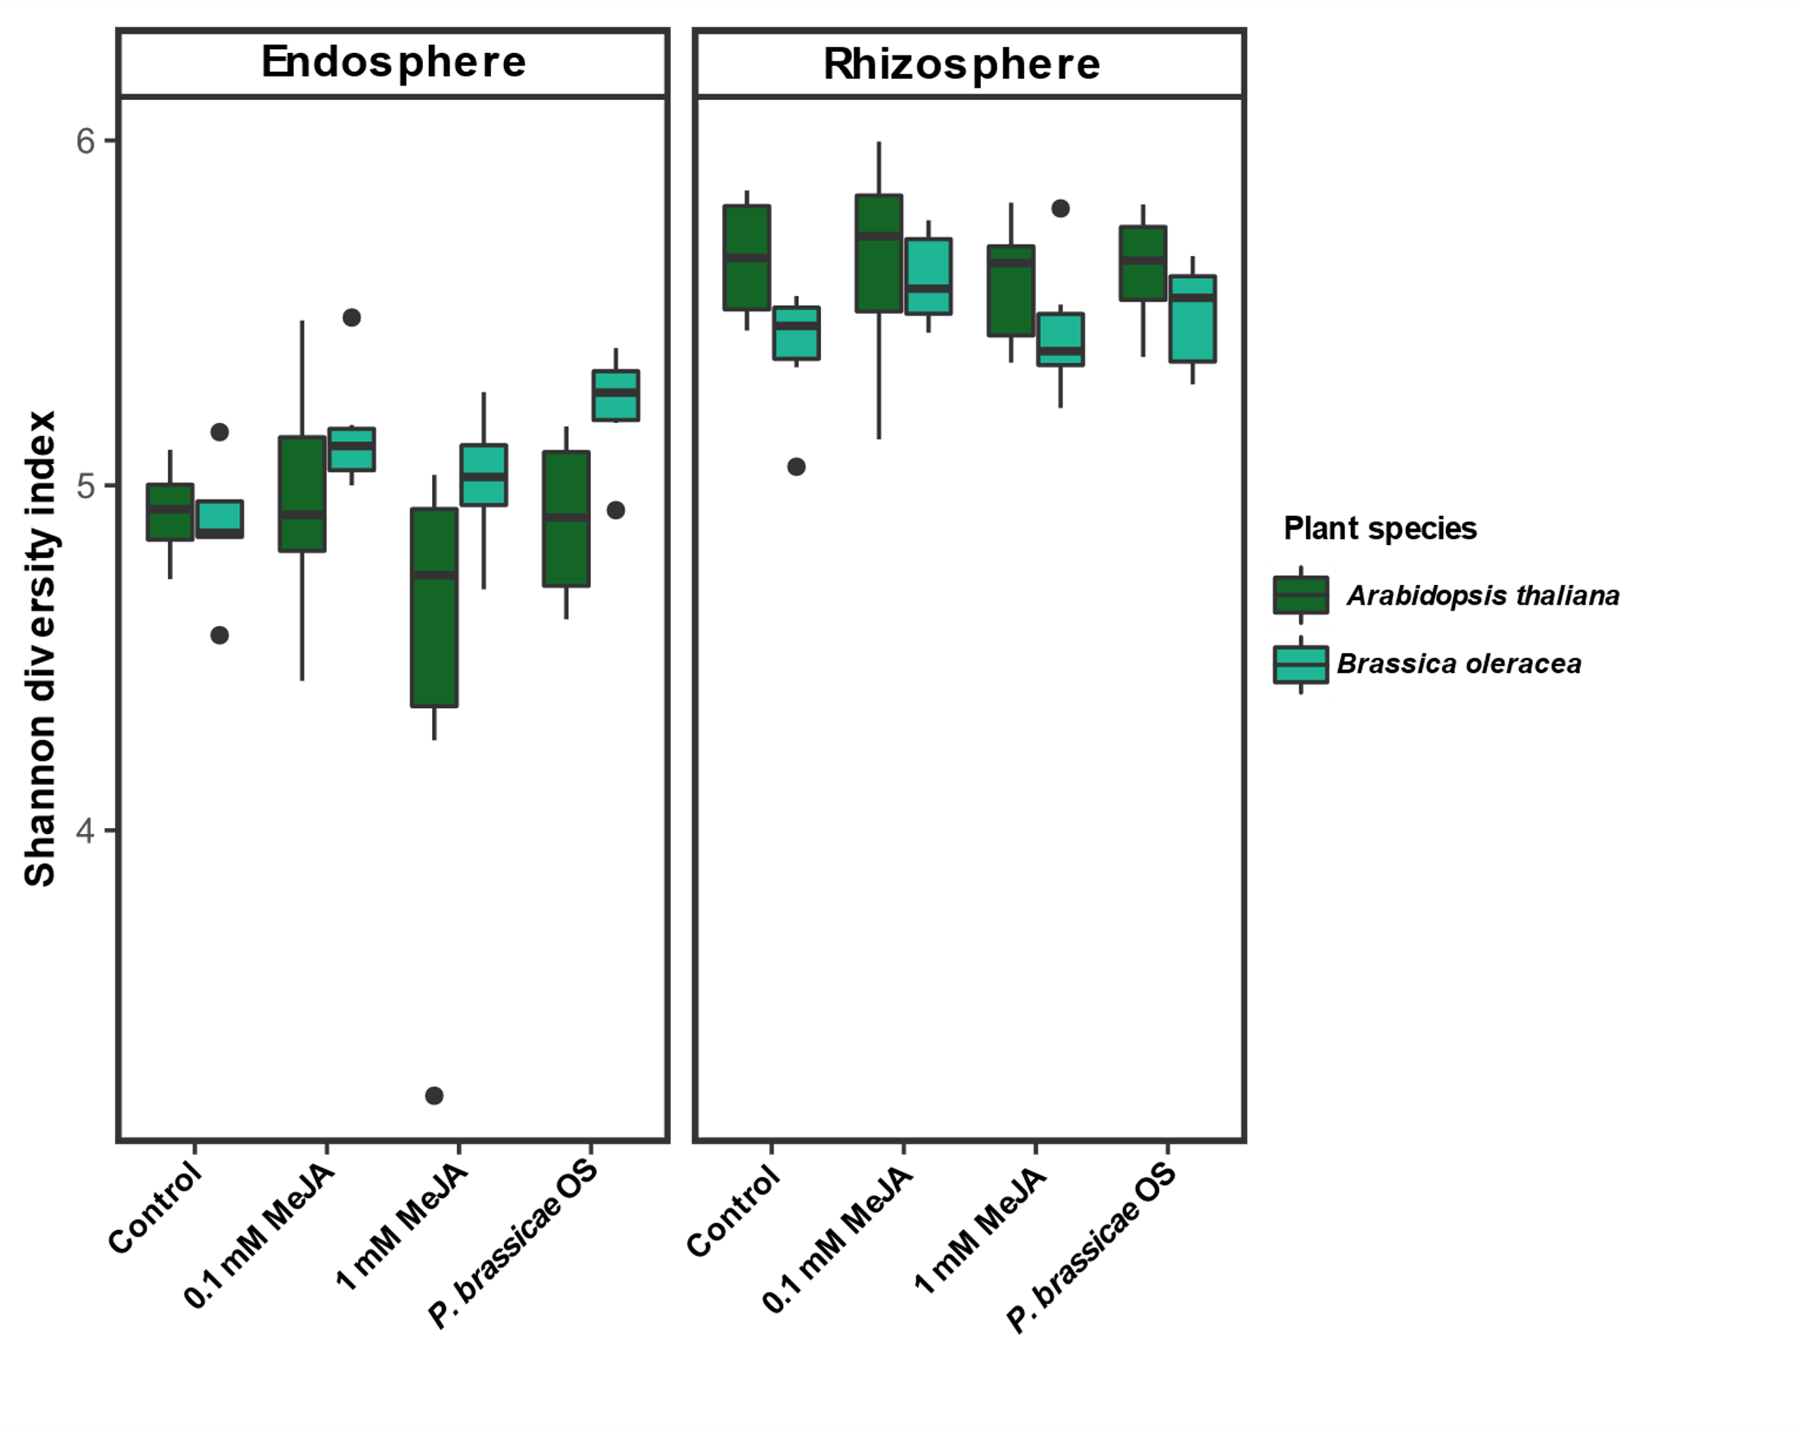
Results
Beta & alpha diversity (Basic analysis present in any paper)
1 figure, full community Shannon diversity [MAIN]
Figure X. Full community Shannon diversity [MAIN]. Shannon diversity index of the microbial communities across plant species, root compartment and stress treatments. Boxplot height corresponds to the first and third quartiles, dark middle line to the median. Black dots represent outliers. N=4-6.

Slide 14
Results
Beta & alpha diversity (Basic analysis present in any paper)
2 tables, ANOVA and post-hoc [2 SUP]: ANOVA
SUP_table_alpha_diversity_tests : ANOVA table of Shannon diversity indexes across the different plant species and sample types. SumOfSqs = Sum of Squares, Df = degrees of freedom, asterisks indicate significant differences
 | Df | SumOfSqs | F value | P value
Block | 5 | 0.597 | 1.7681 | 0.130323
Plant species | 1 | 0.0526 | 0.7782 | 0.380634
Treatment | 3 | 0.5908 | 2.9161 | 0.039974 | *
Sample type | 1 | 8.6669 | 128.3363 | 2.20E-16 | ***
Plant species:Treatment | 3 | 0.34 | 1.6783 | 0.179269
Plant species:Sample type | 1 | 0.9281 | 13.7431 | 0.000409 | ***
MeJA treatment:Sample type | 3 | 0.218 | 1.076 | 0.364794
Plant species:Treatment:Sample type | 3 | 0.1909 | 0.9424 | 0.424793
Residuals | 72 | 4.8624

Slide 15
Results
Beta & alpha diversity (Basic analysis present in any paper)
2 tables, ANOVA and post-hoc [2 SUP]: post-hoc
Treatment | Plant Species | Plant compartment | Shannon Diversity | Tukey post-hoc groups
control | Arabidopsis thaliana | Rhizosphere | 5.657 | a
MeJA_0.1 | Arabidopsis thaliana | Rhizosphere | 5.648 | a
oral_secretion | Arabidopsis thaliana | Rhizosphere | 5.628 | a
MeJA_0.1 | Brassica oleraceae | Rhizosphere | 5.598 | a
MeJA_1.0 | Arabidopsis thaliana | Rhizosphere | 5.590 | a
oral_secretion | Brassica oleraceae | Rhizosphere | 5.495 | ab
MeJA_1.0 | Brassica oleraceae | Rhizosphere | 5.446 | abc
control | Brassica oleraceae | Rhizosphere | 5.399 | abc
oral_secretion | Brassica oleraceae | Endosphere | 5.230 | abc
MeJA_0.1 | Brassica oleraceae | Endosphere | 5.153 | abc
MeJA_1.0 | Brassica oleraceae | Endosphere | 5.013 | bcd
MeJA_0.1 | Arabidopsis thaliana | Endosphere | 4.955 | bcd
control | Arabidopsis thaliana | Endosphere | 4.922 | cd
oral_secretion | Arabidopsis thaliana | Endosphere | 4.899 | cd
control | Brassica oleraceae | Endosphere | 4.877 | cd
MeJA_1.0 | Arabidopsis thaliana | Endosphere | 4.495 | d

Slide 16
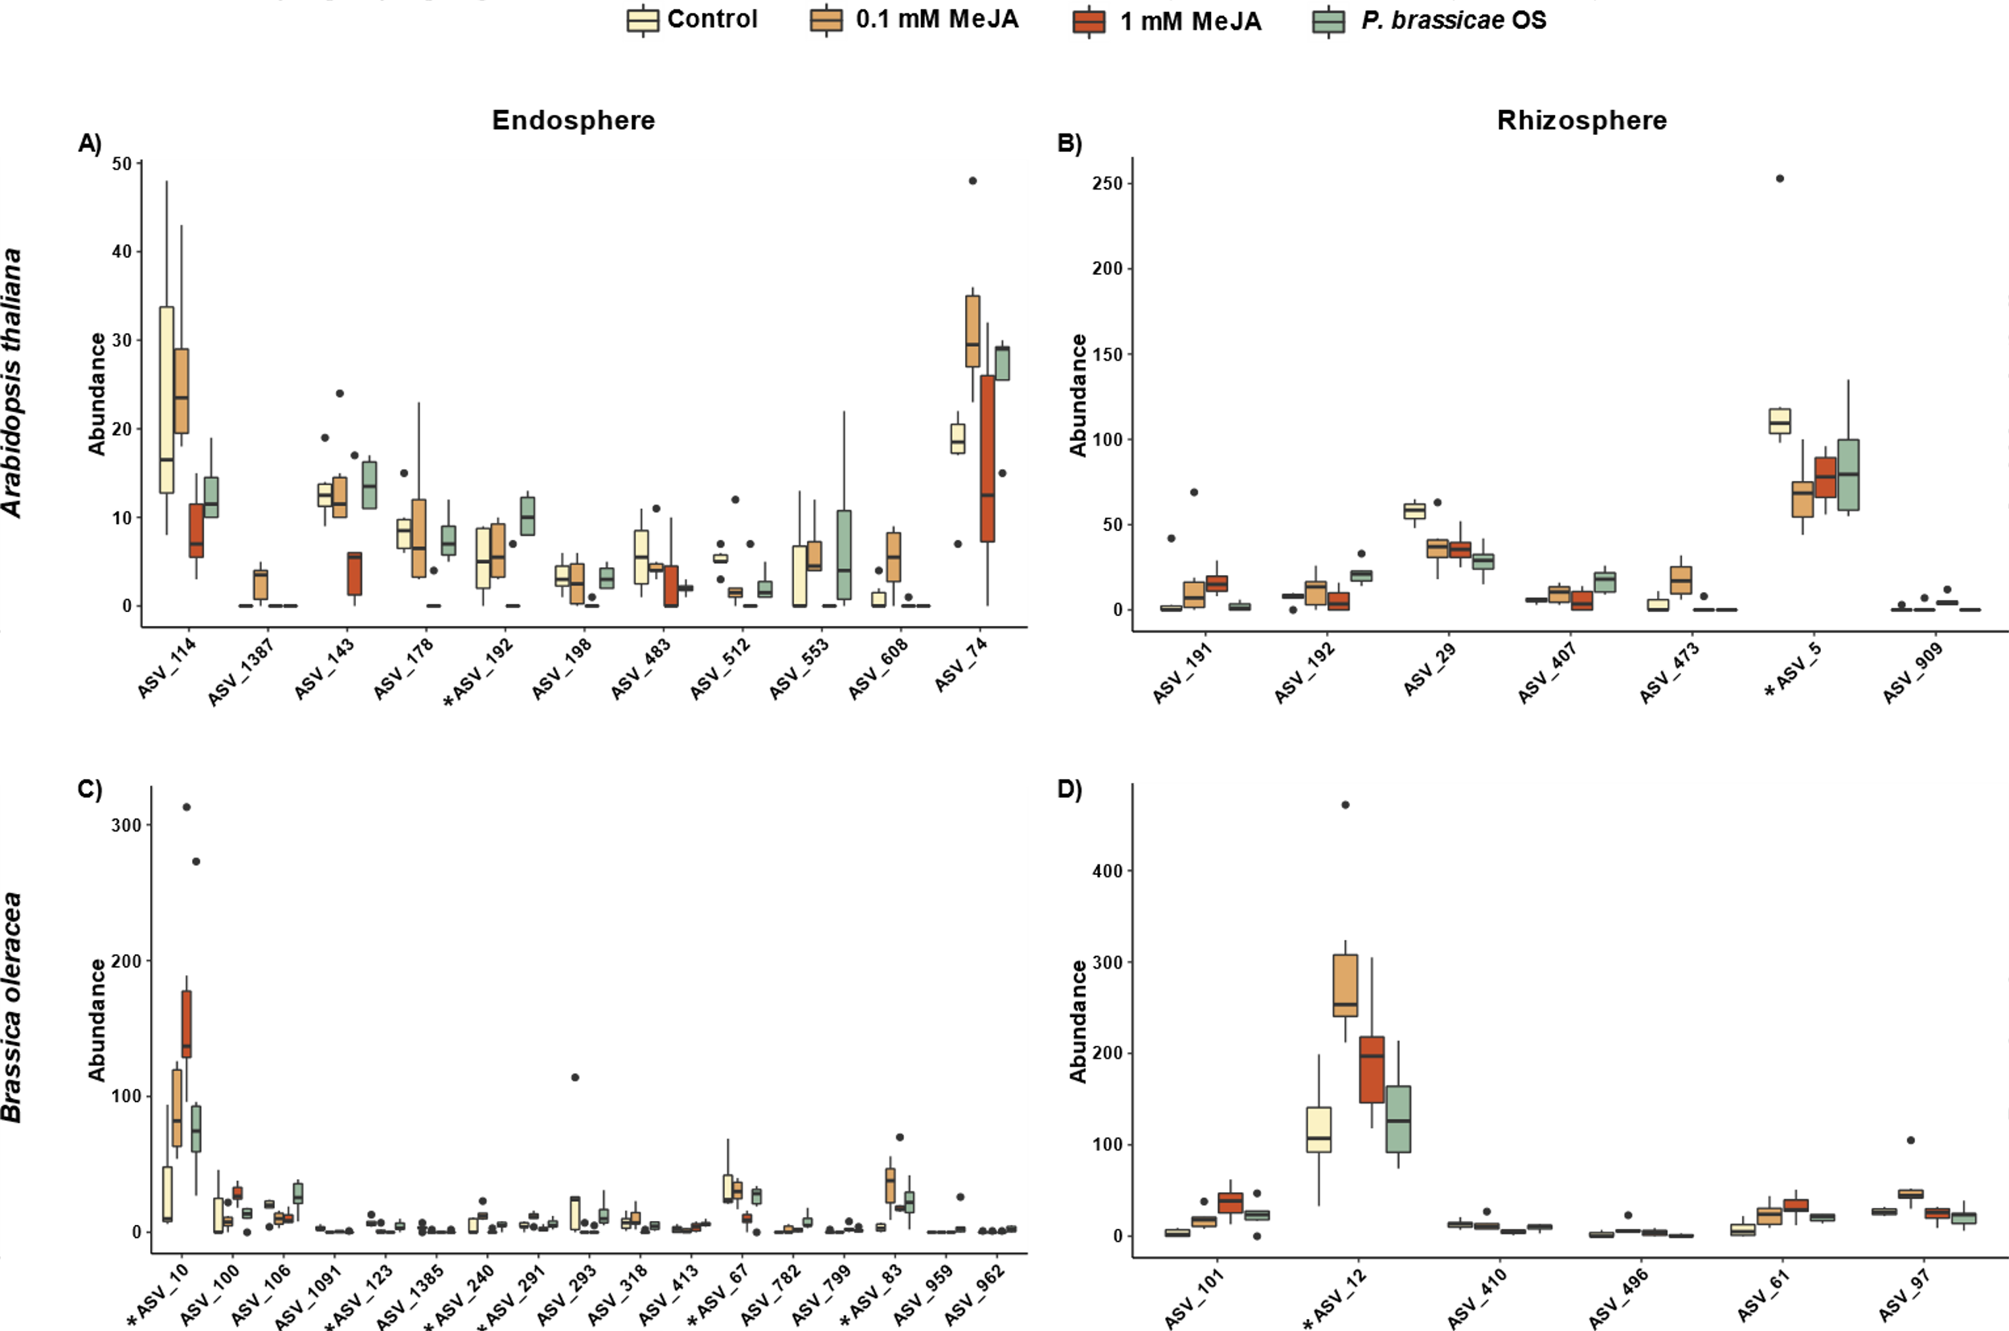
Results
Random forest (show ASVs that matter on prediction)
1 Figure with 4 panels, ASV abundance per treatment [MAIN or SUP?]
Figure X. ASV abundance per treatment [MAIN or SUP?]
Random forest output showing the abundance of ASVs selected as predictors for stress treatment in each data partition. ASVs belonging to Commamonadaceae family are indicated with an asterisk.
Notes:
+Network analysis
+Check Network analysis in papers of microbiome

Slide 17
Results
Random forest (show ASVs that matter on prediction)
3 tables: sample size + precision + kappa, confusion matrix, ASV taxonomies [3 SUP]
SUP_ Table_RF_output: Summary of Random Forest models performance. Sample partition = plant species and sample type; Sample Size = number of samples in each partition; Model = Whether the full community or the Boruta-selected features were utilized as an input; input ASVs = number of ASVs in the input dataset ; Accuracy and Kappa are defined in the methods section.
Plant Species | Sample type | Sample Size | Model | input ASVs | Accuracy | Kappa
A. thaliana | endosphere | 22 | Full community RF | 2690 | 0.3282 | 0.1097
 |  | 22 | Boruta-selected RF | 11 | 0.8086 | 0.7426
 | rhizosphere | 24 | Full community RF | 3124 | 0.3571 | 0.1750
 |  | 24 | Boruta-selected RF | 7 | 0.8204 | 0.7609
B.oleracea | endosphere | 23 | Full community RF | 2421 | 0.4898 | 0.3350
 |  | 23 | Boruta-selected RF | 16 | 0.8911 | 0.8533
 | rhizosphere | 24 | Full community RF | 2558 | 0.3533 | 0.0908
 |  | 24 | Boruta-selected RF | 6 | 0.6784 | 0.6714

Slide 18
Results
Random forest (show ASVs that matter on prediction)
3 tables: sample size + precision + kappa, confusion matrix, ASV taxonomies [3 SUP]
SUP_ table_confusion_matrix: Confusion matrix performance of the random forest model when using only the Boruta-selected features. Values outside the diagonals indicate misclassifications by the Random forest algorithm.
AT Endo (n=22) |  | Reference |  |  |  |  | AT Rhizo (n=24) |  | Reference
11 of 2690 ASVs |  | Control | MeJA 0.1 | MeJA 1.0 | Oral |  | 7 of 3124 ASVs |  | Control | MeJA 0.1 | MeJA 1.0 | Oral
Prediction | Control | 22 | 5.1 | 2.8 | 5.3 |  | Prediction | Control | 20.8 | 4.2 | 1.2 | 0.4
 | MeJA 0.1 | 0.3 | 21.3 | 0 | 0 |  |  | MeJA 0.1 | 0.3 | 15.1 | 0.6 | 0.7
 | MeJA 1.0 | 0 | 0.8 | 24.5 | 0 |  |  | MeJA 1.0 | 3.9 | 3.2 | 21.8 | 0
 | Oral | 4.8 | 0.1 | 0 | 13 |  |  | Oral | 0 | 2.5 | 1.4 | 24
 |  | Accuracy: 0.8086 |  | Kappa: 0.7426 |  |  |  |  | Accuracy: 0.8167 |  | Kappa: 0.7609
BO Endo (n=23) |  | Reference |  |  |  |  | BO Rhizo (n=24) |  | Reference
16 of 2421 ASVs |  | Control | MeJA 0.1 | MeJA 1.0 | Oral |  | 6 of 2558 ASVs |  | Control | MeJA 0.1 | MeJA 1.0 | Oral
Prediction | Control | 19 | 0.3 | 0 | 3.3 |  | Prediction | Control | 19.5 | 0 | 0 | 5.1
 | MeJA 0.1 | 0.4 | 25.8 | 0 | 0.1 |  |  | MeJA 0.1 | 0.1 | 21.5 | 4 | 1.4
 | MeJA 1.0 | 0 | 0 | 26.1 | 4.3 |  |  | MeJA 1.0 | 1.2 | 3.5 | 14 | 5.8
 | Oral | 2.4 | 0 | 0 | 18 |  |  | Oral | 4.82 | 0 | 7 | 13
 |  | Accuracy: 0.8911 |  | Kappa: 0.8533 |  |  |  |  | Accuracy: 0.6784 |  | Kappa: 0.6714

Slide 19
Results
Random forest (show ASVs that matter on prediction)
3 tables: sample size + precision + kappa, confusion matrix, ASV taxonomies [3 SUP]
Plant species | Sample type | ASV ID | Phylum | Class | Order | Family | Genus | Mean Importance
A. thaliana | Endosphere | ASV_74 | p__Proteobacteria | c__Gammaproteobacteria | o__Burkholderiales | f__Oxalobacteraceae | g__Massilia | 19.092
 |  | ASV_114 | p__Bacteroidota | c__Bacteroidia | o__Chitinophagales | f__Chitinophagaceae | g__Niastella | 11.331
 |  | ASV_143 | p__Bacteroidota | c__Bacteroidia | o__Chitinophagales | f__Chitinophagaceae | g__Ferruginibacter | 14.558
 |  | ASV_178 | p__Bacteroidota | c__Bacteroidia | o__Chitinophagales | f__Chitinophagaceae | g__Niastella | 20.855
 |  | ASV_192 | p__Proteobacteria | c__Gammaproteobacteria | o__Burkholderiales | f__Comamonadaceae | g__Rubrivivax | 13.01
 |  | ASV_198 | p__Acidobacteriota | c__Holophagae | o__Holophagales | f__Holophagaceae | g__Holophaga | 11.313
 |  | ASV_483 | p__Myxococcota | c__Polyangia | o__Polyangiales | f__Polyangiaceae | g__Pajaroellobacter | 10.025
 |  | ASV_512 | p__Spirochaetota | c__Leptospirae | o__Leptospirales | f__Leptospiraceae | g__Leptospira | 15.829
 |  | ASV_553 | p__Chloroflexi | c__Ktedonobacteria | o__Ktedonobacterales | f__Ktedonobacteraceae | g__uncultured | 12.509
 |  | ASV_608 | p__Myxococcota | c__Polyangia | o__Polyangiales | f__BIrii41 | g__BIrii41 | 13.888
 |  | ASV_1387 | p__Proteobacteria | c__Gammaproteobacteria | o__Burkholderiales | f__Oxalobacteraceae | g__Massilia | 14.411
 | Rhizosphere | ASV_5 | p__Proteobacteria | c__Gammaproteobacteria | o__Burkholderiales | f__Comamonadaceae | g__Rhizobacter | 15.401
 |  | ASV_29 | p__Proteobacteria | c__Alphaproteobacteria | o__Rhizobiales | f__Xanthobacteraceae | g__Bradyrhizobium | 21.212
 |  | ASV_191 | p__Proteobacteria | c__Gammaproteobacteria | o__Burkholderiales | f__Oxalobacteraceae | g__Massilia | 19.722
 |  | ASV_192 | p__Proteobacteria | c__Gammaproteobacteria | o__Burkholderiales | f__Comamonadaceae | g__Rubrivivax | 20.851
 |  | ASV_407 | p__Bacteroidota | c__Bacteroidia | o__Chitinophagales | f__Chitinophagaceae | g__Ferruginibacter | 19.078
 |  | ASV_473 | p__Proteobacteria | c__Alphaproteobacteria | o__Rhizobiales | f__Xanthobacteraceae | g__uncultured | 25.946
 |  | ASV_909 | p__Proteobacteria | c__Alphaproteobacteria | o__Caulobacterales | f__Caulobacteraceae | g__Asticcacaulis | 26.75
B. oleracea | Endosphere | ASV_10 | p__Proteobacteria | c__Gammaproteobacteria | o__Burkholderiales | f__Comamonadaceae | g__Acidovorax | 12.037
 |  | ASV_67 | p__Proteobacteria | c__Gammaproteobacteria | o__Burkholderiales | f__Comamonadaceae | NA | 18.616
 |  | ASV_83 | p__Proteobacteria | c__Gammaproteobacteria | o__Burkholderiales | f__Comamonadaceae | NA | 15.693
 |  | ASV_100 | p__Bacteroidota | c__Bacteroidia | o__Sphingobacteriales | f__Sphingobacteriaceae | g__Pedobacter | 12.396
 |  | ASV_106 | p__Verrucomicrobiota | c__Chlamydiae | o__Chlamydiales | f__Parachlamydiaceae | g__Candidatus_Protochlamydia | 12.973
 |  | ASV_123 | p__Proteobacteria | c__Gammaproteobacteria | o__Burkholderiales | f__Comamonadaceae | g__Rhizobacter | 14.055
 |  | ASV_240 | p__Proteobacteria | c__Gammaproteobacteria | o__Burkholderiales | f__Comamonadaceae | g__Leptothrix | 21.175
 |  | ASV_291 | p__Proteobacteria | c__Gammaproteobacteria | o__Burkholderiales | f__Comamonadaceae | g__Leptothrix | 10.406
 |  | ASV_293 | p__Proteobacteria | c__Gammaproteobacteria | o__Burkholderiales | f__Oxalobacteraceae | NA | 12.844
 |  | ASV_318 | p__Proteobacteria | c__Gammaproteobacteria | o__Burkholderiales | f__Burkholderiaceae | g__Burkholderia-Caballeronia-Paraburkholderia | 16.645
 |  | ASV_413 | p__Chloroflexi | c__Ktedonobacteria | o__C0119 | f__C0119 | g__C0119 | 11.519
 |  | ASV_782 | p__Bacteroidota | c__Bacteroidia | o__Cytophagales | f__Cytophagaceae | g__Cytophaga | 14.745
 |  | ASV_799 | p__Planctomycetota | c__Planctomycetes | o__Planctomycetales | f__uncultured | g__uncultured | 12.979
 |  | ASV_959 | p__Bacteroidota | c__Bacteroidia | o__Flavobacteriales | f__Flavobacteriaceae | g__Flavobacterium | 11.165
 |  | ASV_962 | p__Proteobacteria | c__Gammaproteobacteria | o__Burkholderiales | f__Rhodocyclaceae | g__Uliginosibacterium | 10.344
 |  | ASV_1091 | p__Bdellovibrionota | c__Oligoflexia | o__0319-6G20 | f__0319-6G20 | g__0319-6G20 | 16.545
 |  | ASV_1385 | p__Proteobacteria | c__Gammaproteobacteria | o__Burkholderiales | f__Oxalobacteraceae | NA | 12.486
 | Rhizosphere | ASV_12 | p__Proteobacteria | c__Gammaproteobacteria | o__Burkholderiales | f__Comamonadaceae | NA | 16.5
 |  | ASV_61 | p__Proteobacteria | c__Gammaproteobacteria | o__Burkholderiales | f__Oxalobacteraceae | g__Massilia | 18.569
 |  | ASV_97 | p__Bacteroidota | c__Bacteroidia | o__Sphingobacteriales | f__Sphingobacteriaceae | g__Mucilaginibacter | 19.327
 |  | ASV_101 | p__Bacteroidota | c__Bacteroidia | o__Sphingobacteriales | f__Sphingobacteriaceae | g__Pedobacter | 16.441
 |  | ASV_410 | p__Actinobacteriota | c__Actinobacteria | o__Propionibacteriales | f__Nocardioidaceae | g__Nocardioides | 19.108
 |  | ASV_496 | p__Bacteroidota | c__Bacteroidia | o__Sphingobacteriales | f__Sphingobacteriaceae | g__Mucilaginibacter | 16.534
SUP_ table_rf_taxonomies: Taxonomies and mean importance of ASVs tagged as important by Boruta for each data partition.

Slide 20
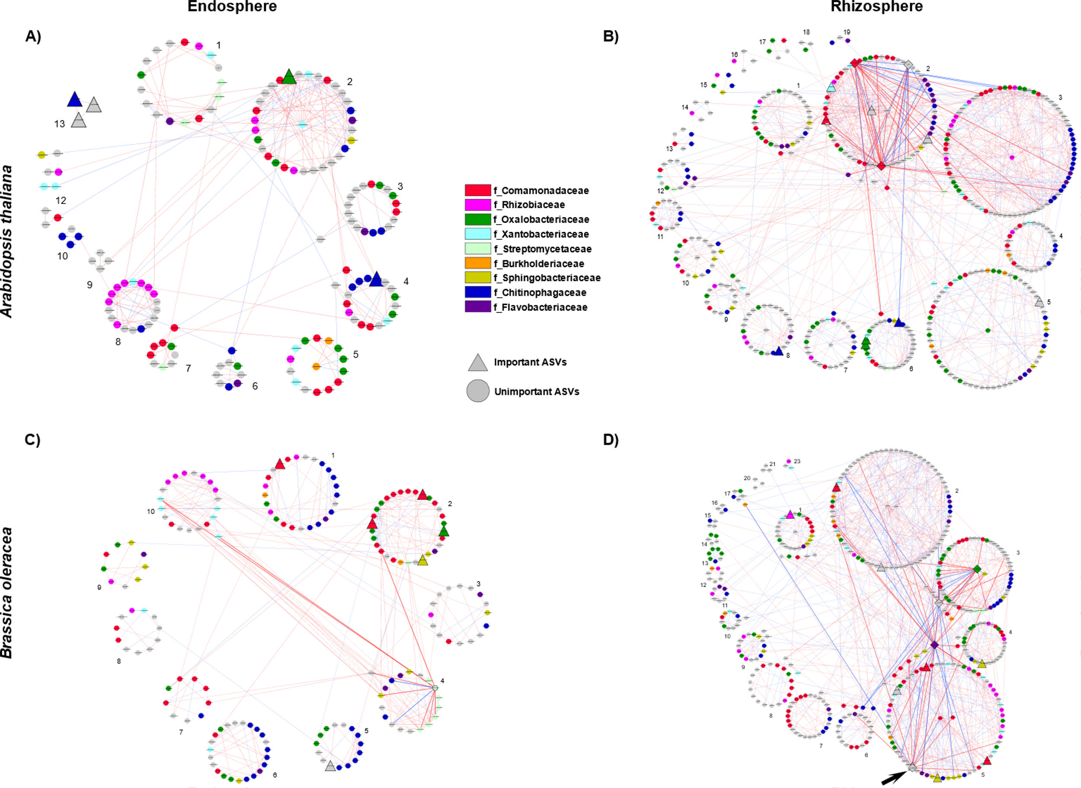
Results
Network analysis (describe networks, ASVs with importance tags, Leave module discussion on supplementary text)
1 figure with 4 panels showing the networks [MAIN or SUP?]
Figure X. ASV abundance per treatment [MAIN or SUP?]
Co-variance networks of A. thaliana endophytic (a) and rhizospheric (b) communities; B. oleraceae endophytic (c) and rhizospheric (d) communities. Groups of nodes represent modules. Red edges represent positive co-variance, and blue edges represent negative co-variance. Nodes in the center of modules are module hubs (Zi >2.5), nodes outside modules are module connectors (pi>0.62). Keystone taxa (significantly high z-transformed degree, betweenness centrality, and closeness centrality) have thicker edges. Triangles represent ASVs important in random forest, diamonds represent keystone taxa.. Node color indicate bacterial families

Slide 21
Results
Network analysis (describe networks, ASVs with importance tags, Leave module discussion on supplementary text)
1 table showing differences to 1000 random networks [SUP]
SUP_table_random_networks: Comparison of global network metrics from calculated real networks and 1000 random networks with the same number of nodes and edges. Real ≠ Random = indicates if the real network metric is outside the mean±2 standard deviations of the random networks. No AT = A. thaliana, BO = B. oleraceae, Endo = Endosphere, Rhizo = Rizosphere
Plant sp. | Sample type | Network | Centralized betweenness | Centralized closeness | Centralized eigenvector | Network transitivity | Network mean shortest path | Network modularity | Mean node betweenness | Mean edge betweenness
AT | Endo | Real network | 0.0371 | 0.1295 | 0.9675 | 0.3333 | 0.1724 | 0.7315 | 209.5 | 316.4
 |  | Random network mean | 0.1053 | 0.0898 | 0.9601 | 0.0038 | 0.3422 | 0.8597 | 691.0 | 1002.7
 |  | Random network sd | 0.0297 | 0.0168 | 0.0155 | 0.0049 | 0.0511 | 0.0150 | 131.5 | 182.3
 |  | Real ≠ Random | Yes | Yes | No | Yes | Yes | Yes | Yes | Yes
 | Rhizo | Real network | 0.0612 | 0.1880 | 0.9538 | 0.2461 | 0.1338 | 0.6294 | 1361.2 | 937.0
 |  | Random network mean | 0.0409 | 0.0999 | 0.8410 | 0.0057 | 0.1384 | 0.5821 | 1774.5 | 1236.2
 |  | Random network sd | 0.0084 | 0.0106 | 0.0348 | 0.0024 | 0.0036 | 0.0063 | 60.3 | 38.4
 |  | Real ≠ Random | Yes | Yes | Yes | Yes | No | Yes | Yes | Yes
BO | Endo | Real network | 0.0447 | 0.1709 | 0.9688 | 0.3327 | 0.1415 | 0.7571 | 261.0 | 384.3
 |  | Random network mean | 0.1035 | 0.0876 | 0.9633 | 0.0032 | 0.3288 | 0.8612 | 860.0 | 1223.9
 |  | Random network sd | 0.0274 | 0.0159 | 0.0139 | 0.0044 | 0.0442 | 0.0129 | 149.4 | 203.0
 |  | Real ≠ Random | Yes | Yes | No | Yes | Yes | Yes | Yes | Yes
 | Rhizo | Real network | 0.0604 | 0.1918 | 0.9537 | 0.2103 | 0.1236 | 0.5976 | 1082.7 | 699.6
 |  | Random network mean | 0.0381 | 0.1019 | 0.8191 | 0.0065 | 0.1221 | 0.5513 | 1591.5 | 1035.0
 |  | Random network sd | 0.0077 | 0.0109 | 0.0364 | 0.0023 | 0.0028 | 0.0061 | 50.0 | 29.4
 |  | Real ≠ Random | Yes | Yes | Yes | Yes | No | Yes | Yes | Yes

Slide 22
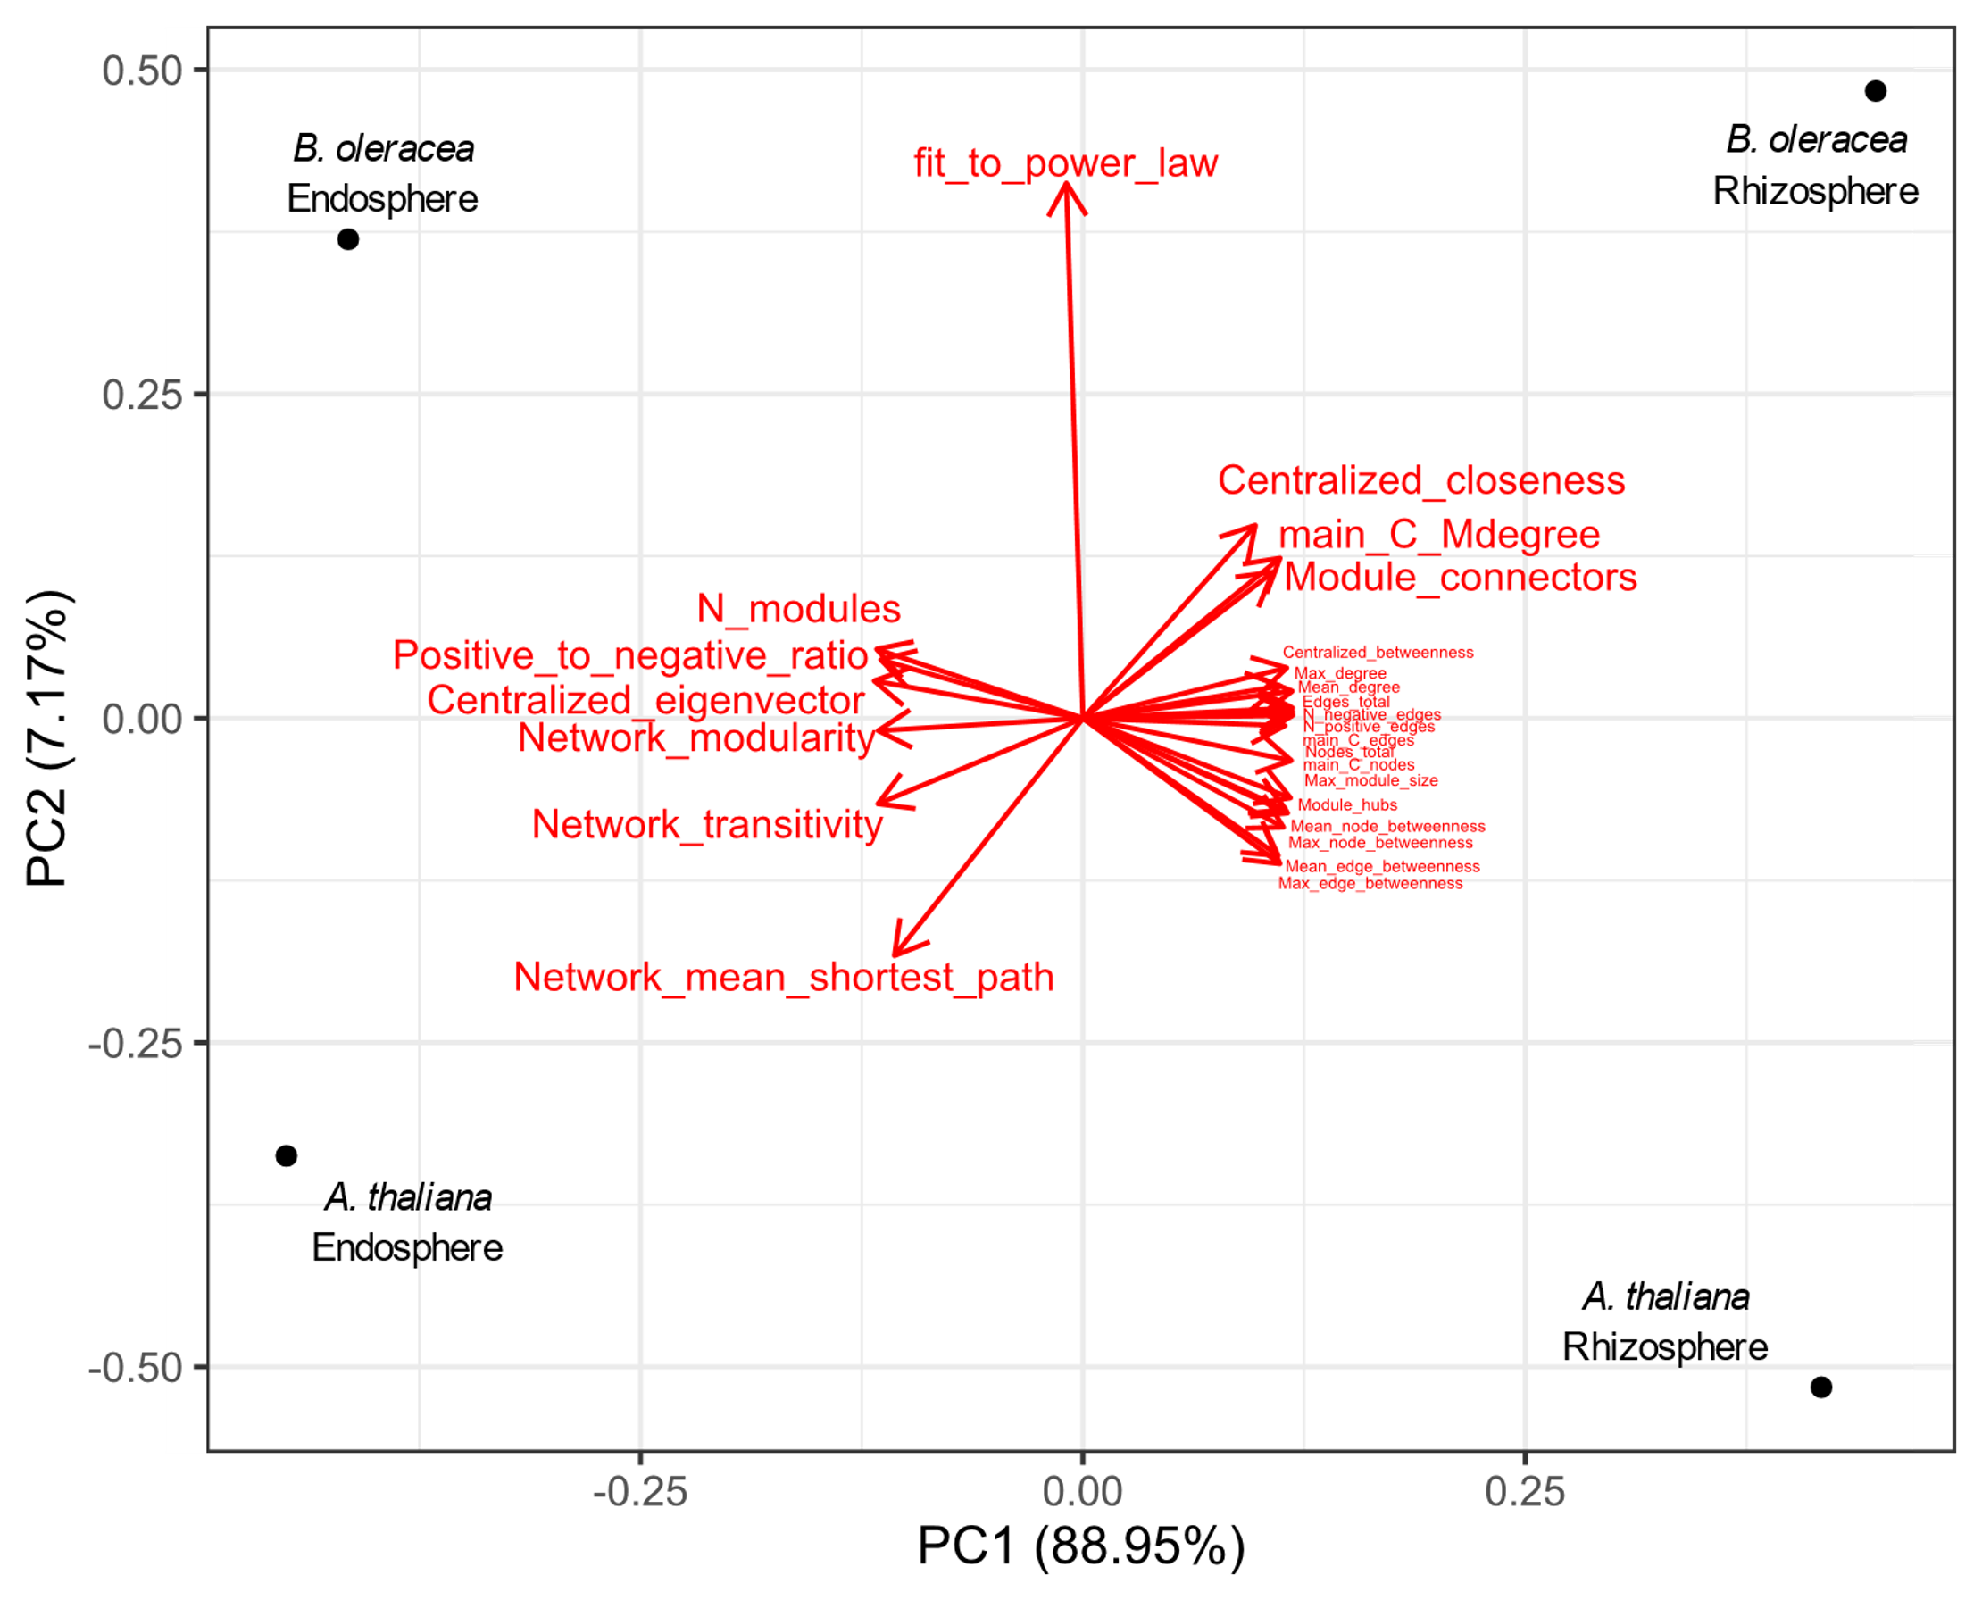
Results
Network analysis (describe networks, ASVs with importance tags, Leave module discussion on supplementary text)
1 figure showing PCA of network metrics [SUP]
Figure X. PCA of network metrics [SUP]: PCA of the network metrics from the 4 networks (one for each data partition). Each line indicates a network metric.

Slide 23
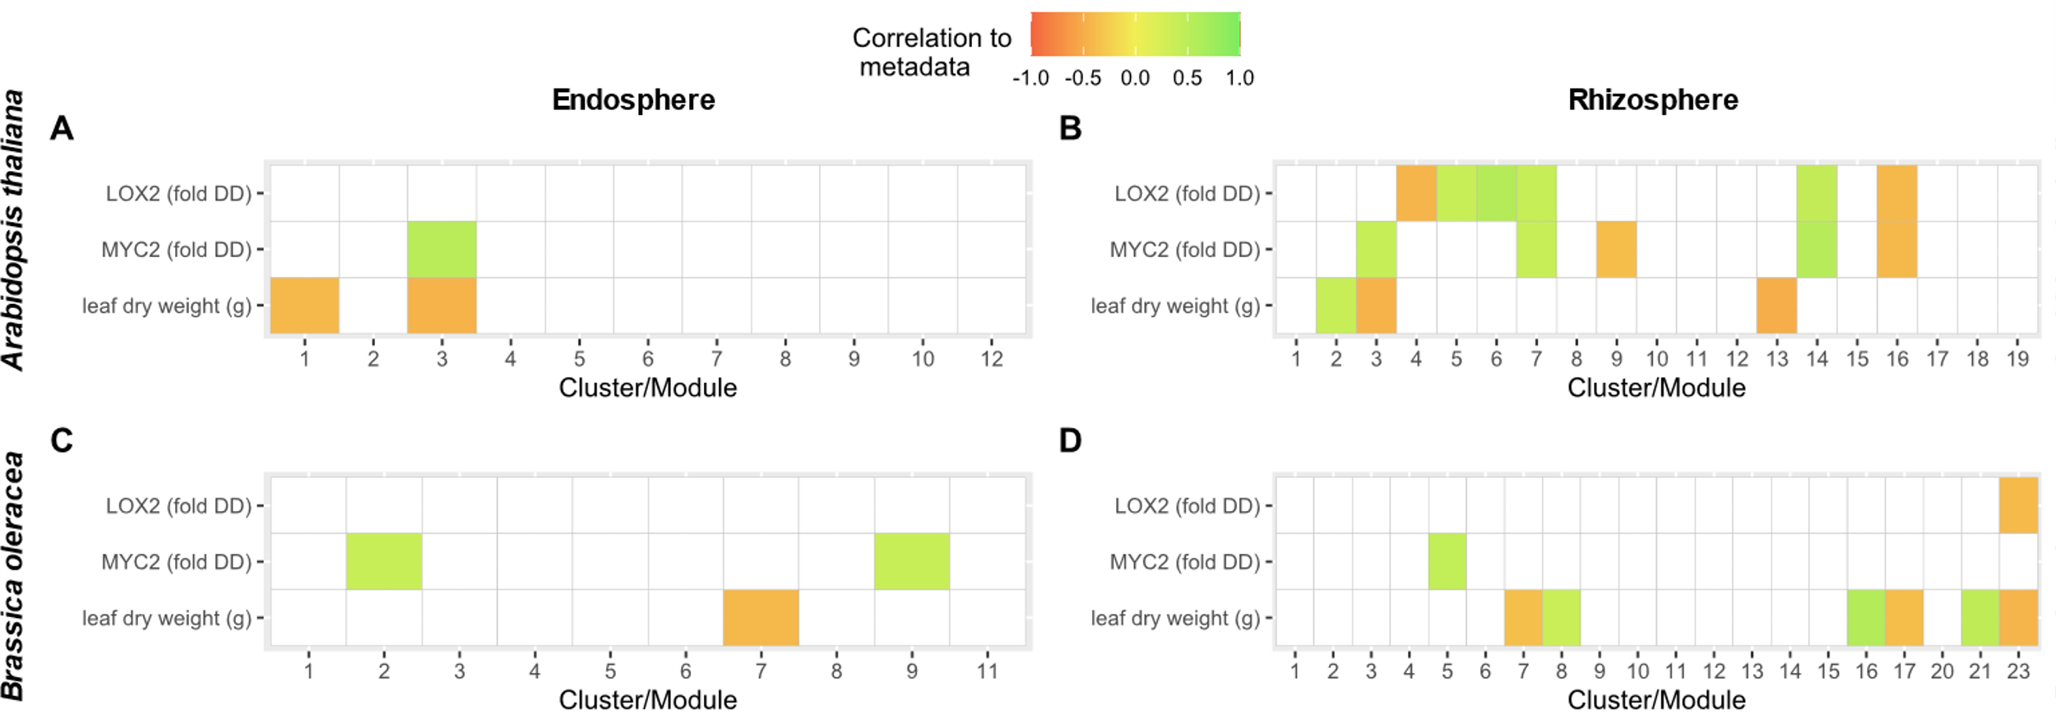
Results
Network analysis (describe networks, ASVs with importance tags, Leave module discussion on supplementary text)
1 figure with 4 panels showing module correlation to metadata [SUP]
[MA] Are both with leaf dry weight calculated? → not good measurement for A. thaliana
Correlations between modules eigengenes (the decomposition of the module’s members CSS-transformed frequencies into a single principal component) and plant phenotype (plant dry weight, MYC2 expression and LOX2 expression). Correlations with p >0,1 are omitted. Modules with less than 2 members and modules detached from the main network component are not shown.

Slide 24
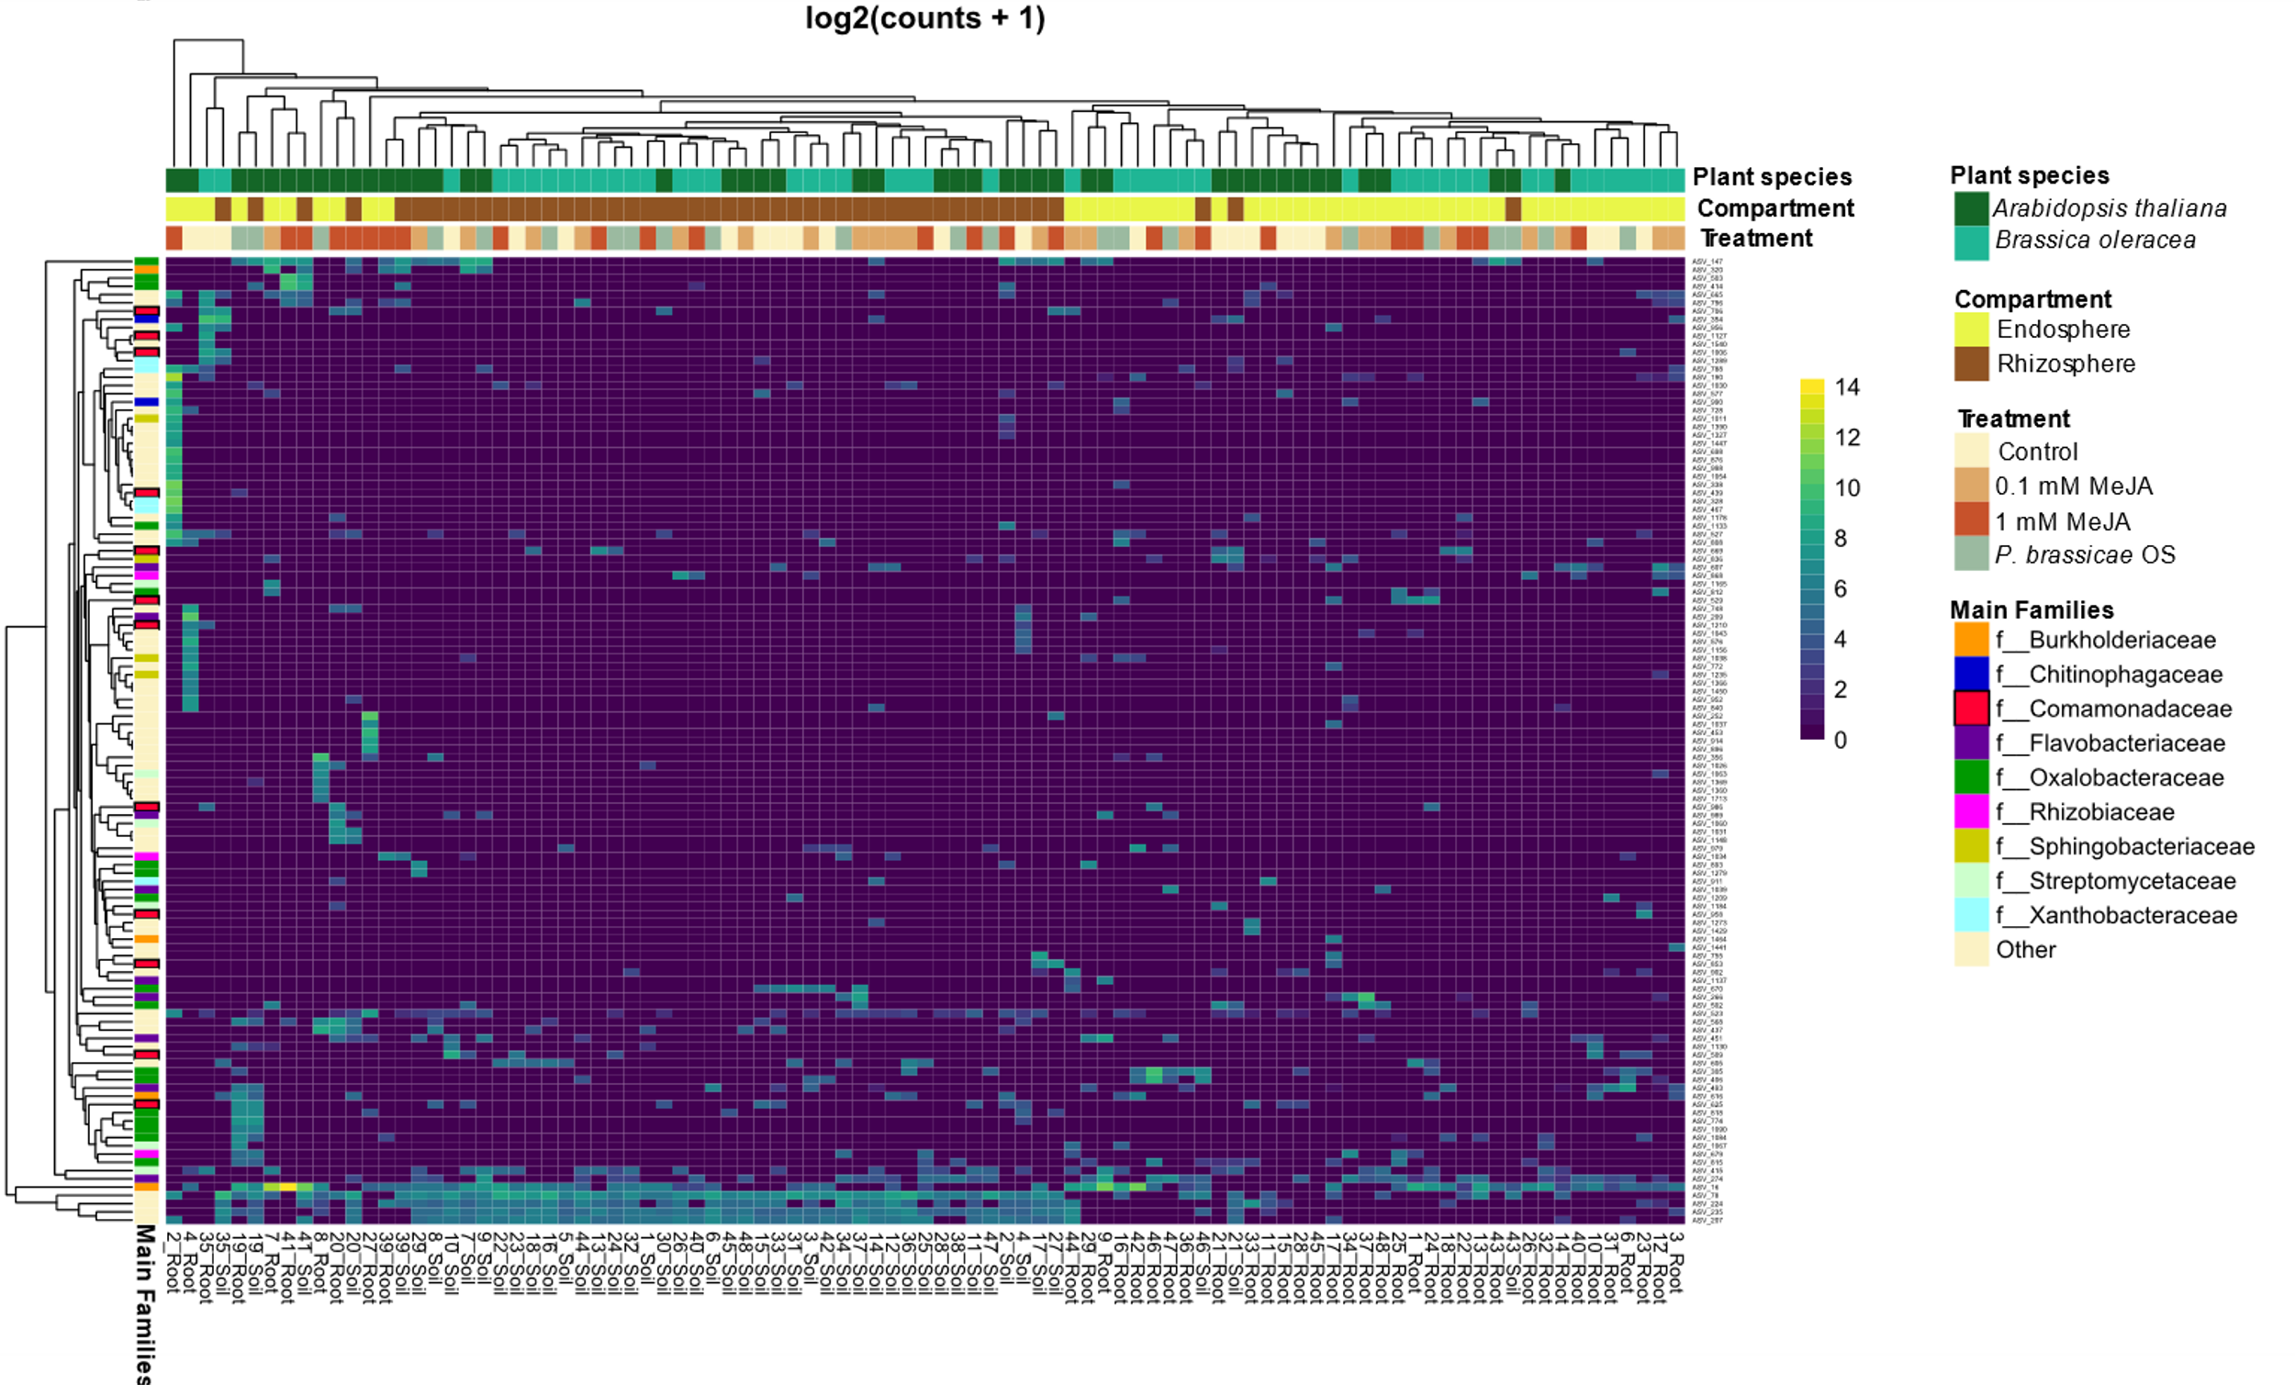
Results
Differential abundance (keep very short)
1 Fig, bi-plot heatmap [SUP or MAIN?]
Figure X. Bi-plot heatmap. Biclustered heatmap representing differentially abundant ASVs in each treatment against their respective controls. Differentially abundant ASVs were selected by DESeq2 with a threshold of false discovery rate <X.X difference between treatment and control. Clustering by treatment and compartment is based on Euclidian distance. ASVs are represented in rows, samples are represented in columns, cell colors represent log2-transformed abundances.

Slide 25
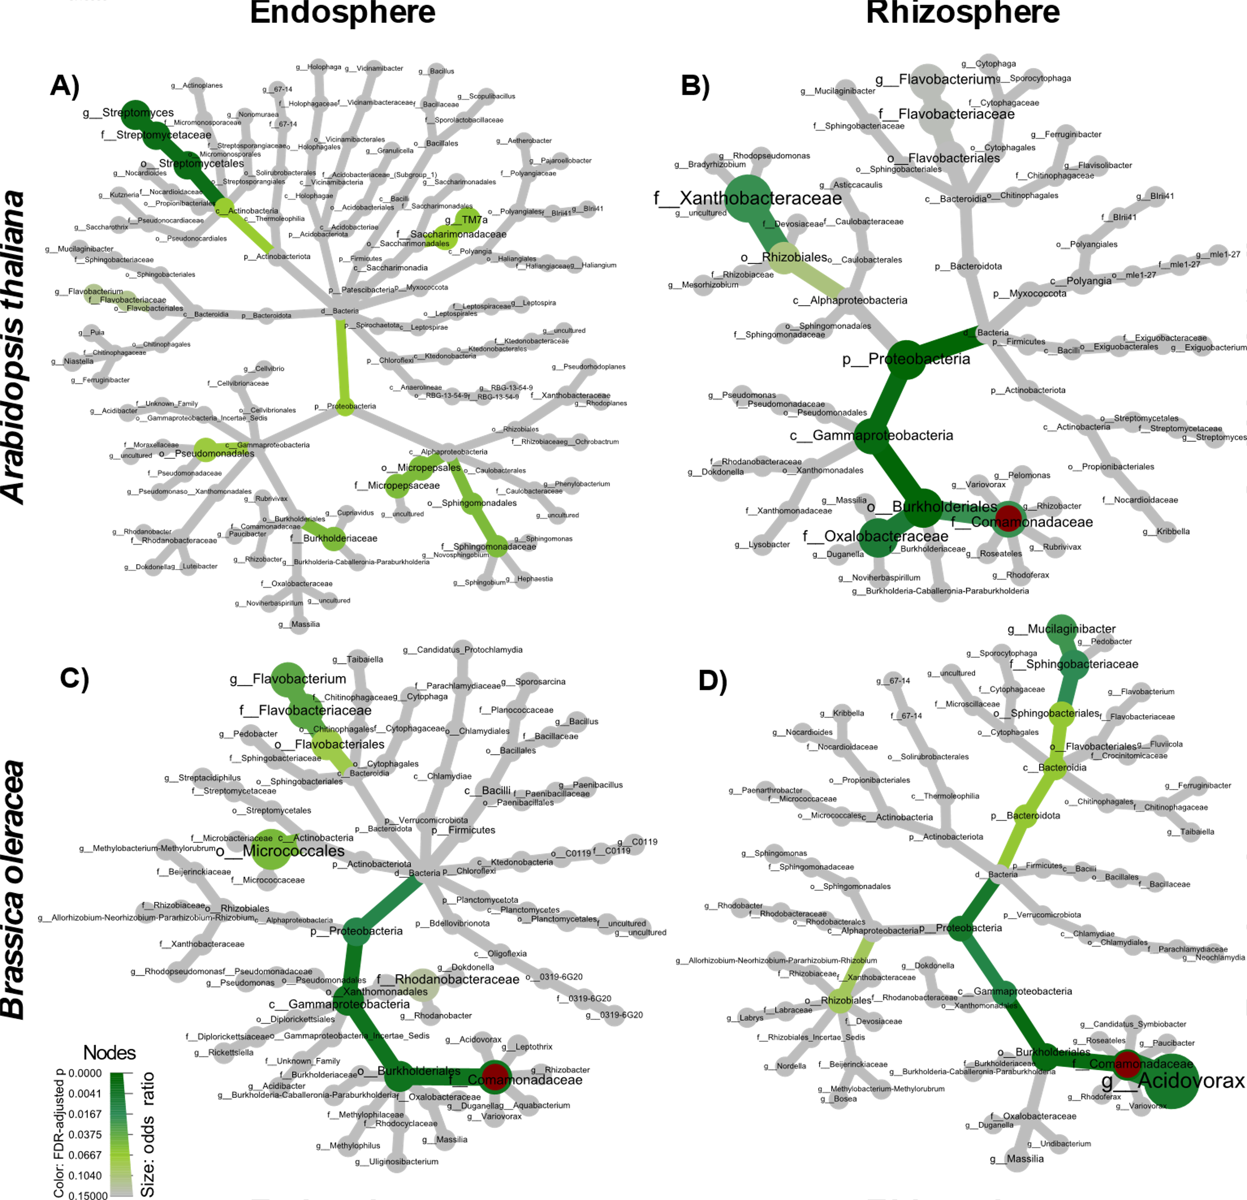
Results
Fisher Summary (describe figure, highlight comamonadaceae)
1 figure with 4 pannels, showing fisher results on tree
Figure X. Fisher summary Summary of “important” ASVs. Proportions in the occurrence of ASVs in each taxa level are tested with Fisher test as in Table 1. An ASV is “important” if highlighted by random forest, network
analysis, or differential abundance. Node colors indicate adjusted p values, node size indicates odds ratio with a maximum of: 12.9 in A. thaliana endosphere (a), 5.8 in A. thaliana rhizosphere (b); 6.1
in B. oleraceae endosphere (c); and 21.3 in B. oleraceae rhizosphere (d) . Comamonadaceae is highlighted in red
[PB] the good news is that in the family experiment comamonadaceae are highlighted in 29/33 sp, and rhizobiales in 25/33 sp. The pipeline was reproduced without any adjustments and can be optimized.

Slide 26
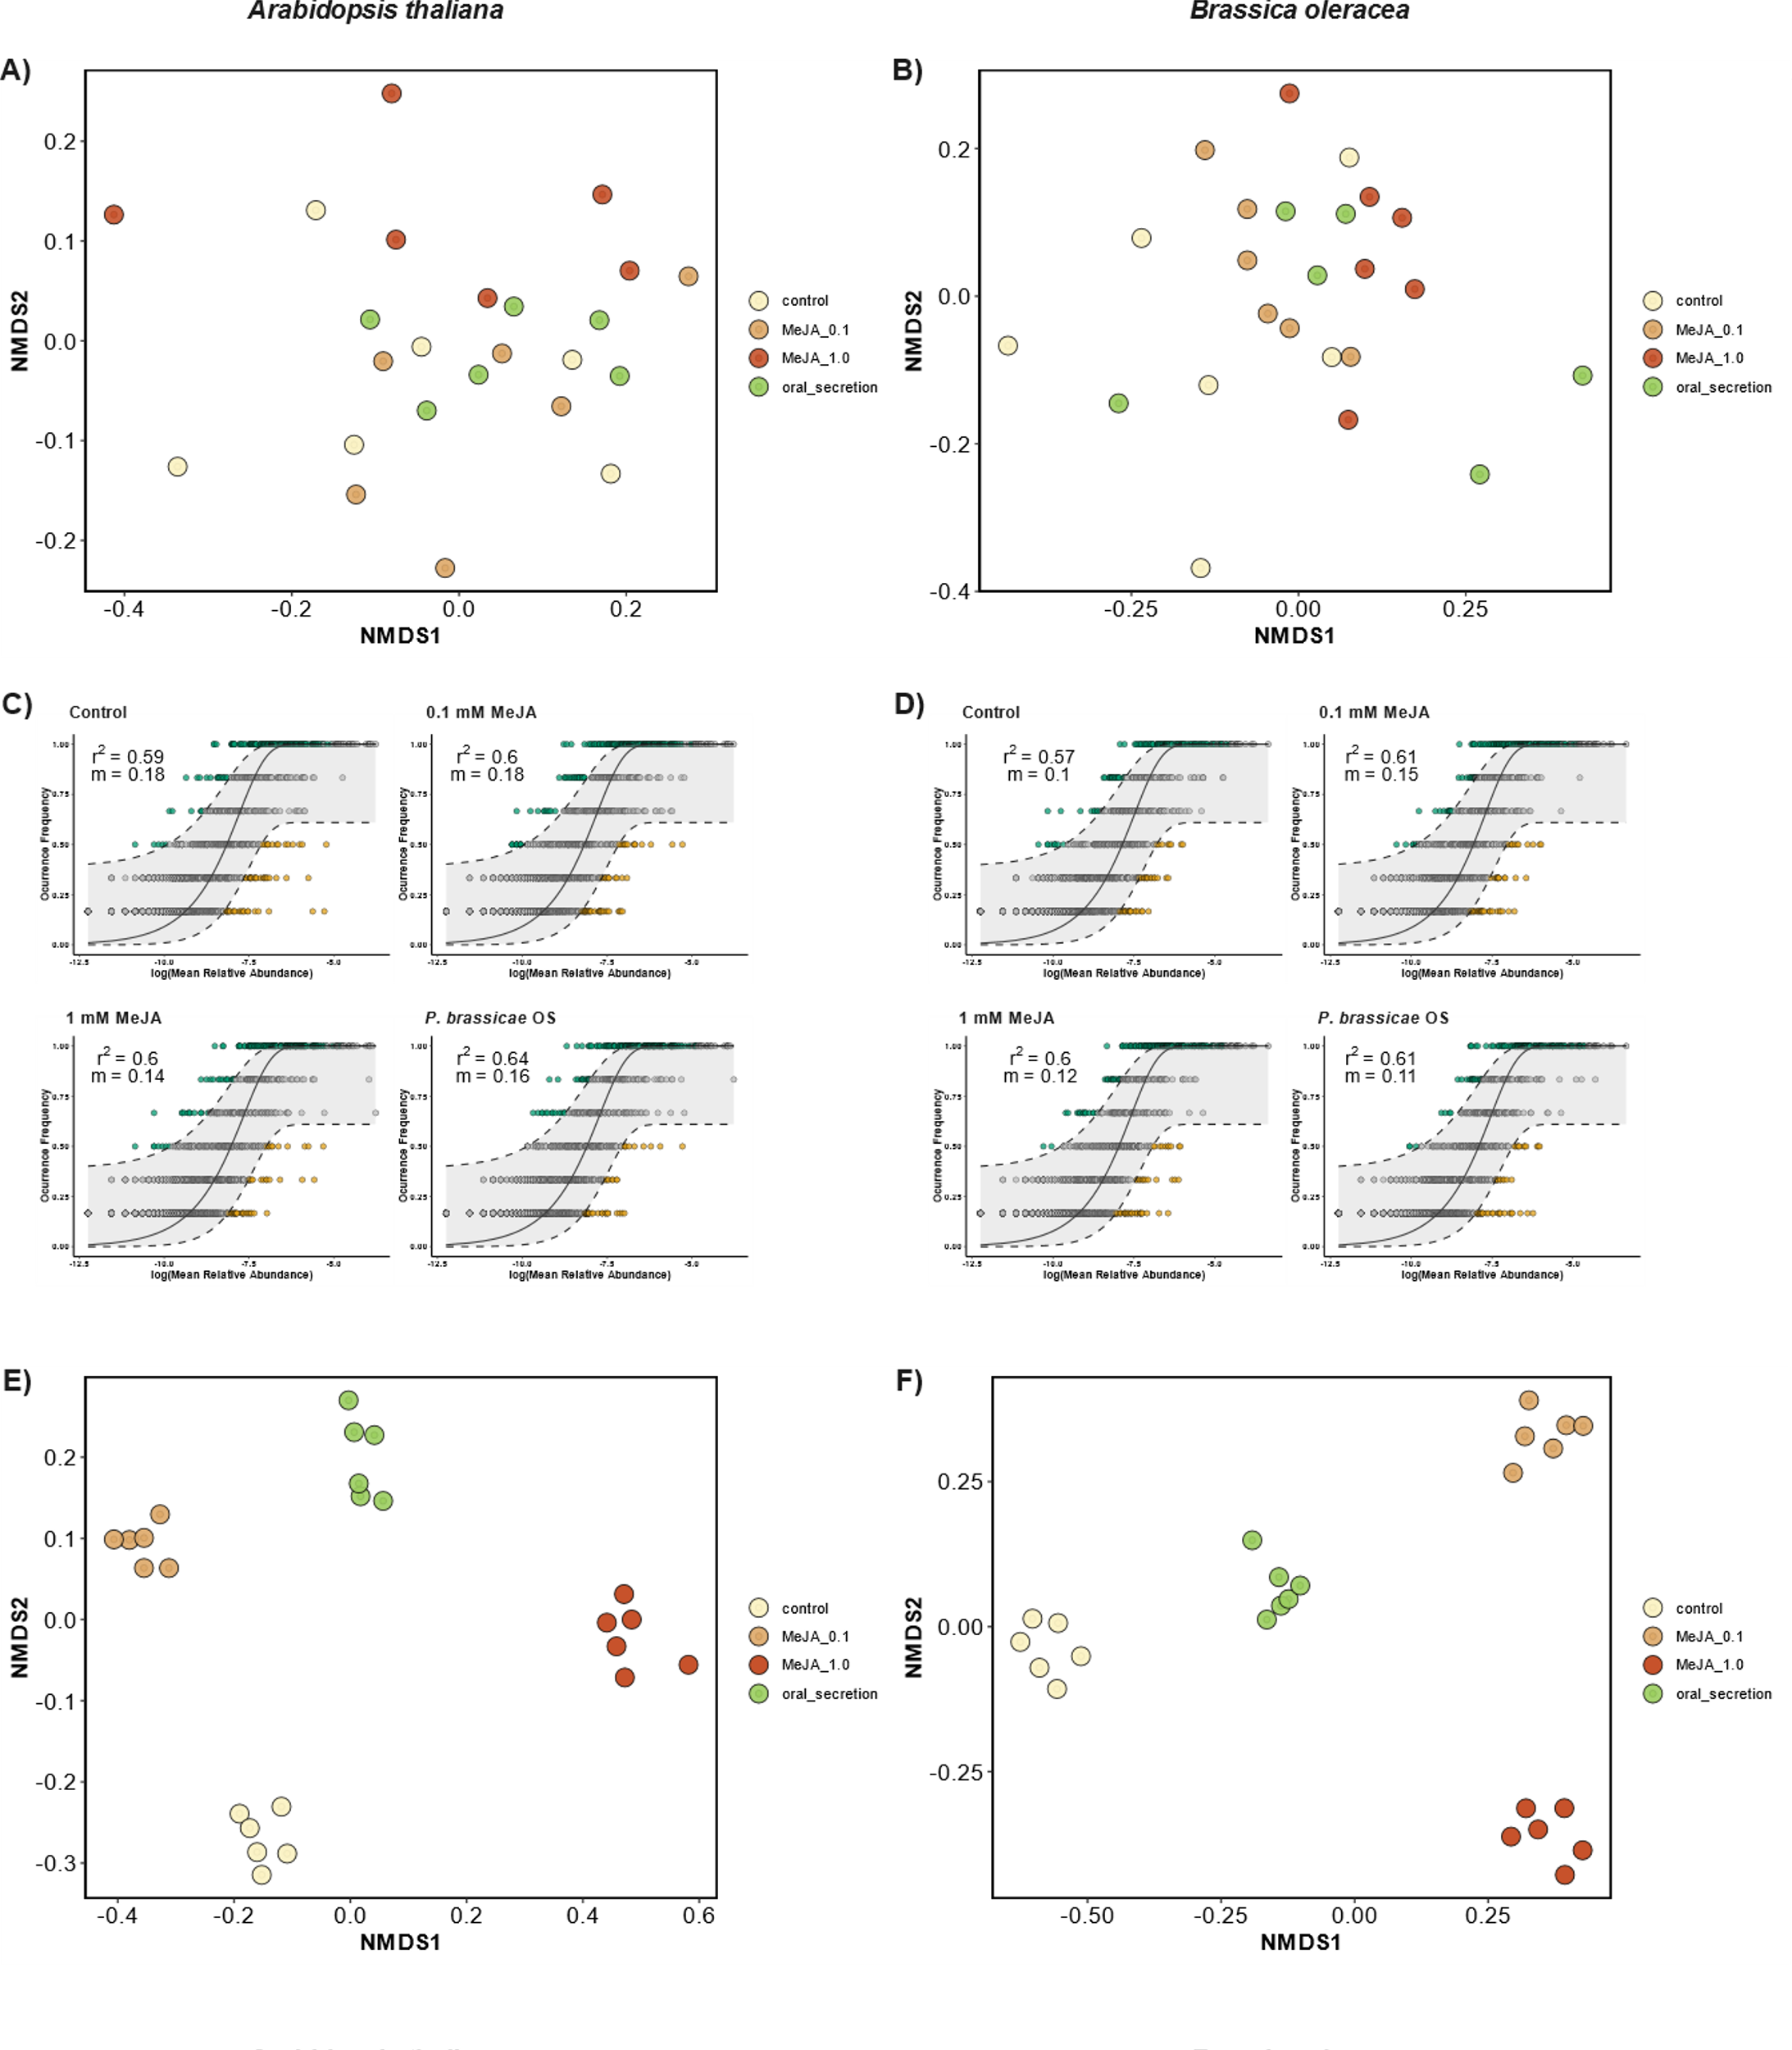
Results
Neutral models
1 Figure with 6 pannels: full rhizosphere ordination + Neutral model fits + above-expected rhizosphere ordination re-plotting [MAIN]
Figure X. Microbial assembly of rhizospheric communities according to a neutral model [MAIN]. Non-metric multi-dimensional scaling (NMDS) plot based on Bray-Curtis distances of rhizospheric communities for A. thaliana and B. oleracea (A-B). Neutral community model (NCM) fit for each stress treatment in both species (C-D). Points are colored whether the occurred frequency per ASV in each of the stress treatments was above (teal), below (yellow) or as predicted (gray) according to the NCM. NMDS plot based on Bray-Curtis distances of the above-predicted subset of ASVs for both species (D-E).
[MA]: I still think this figure needs a bit of adjustment, specially the NCM fit plots, they seem as if the same plot was repeated 4 times.
Invalid result – the huge difference in clustering was caused by an artefact. New version of the content present in the 3 next slides (17-19)
Notes:
+Differential abundance in supplementary
Original: Figure_beta_div_neutral NMDS of MeJA effects on the full community of B. oleraceae and A. thaliana soil samples (a-b), fit of the 4 neutral models in both data partitions, defining in teal colour the ASVs that occur above the expectation of a neutral dispersal model (c-d), NMDS of MeJA effects on the above-expeted taxa subsets of B. oleraceae and A. thaliana soil samples (e-f)

Slide 27
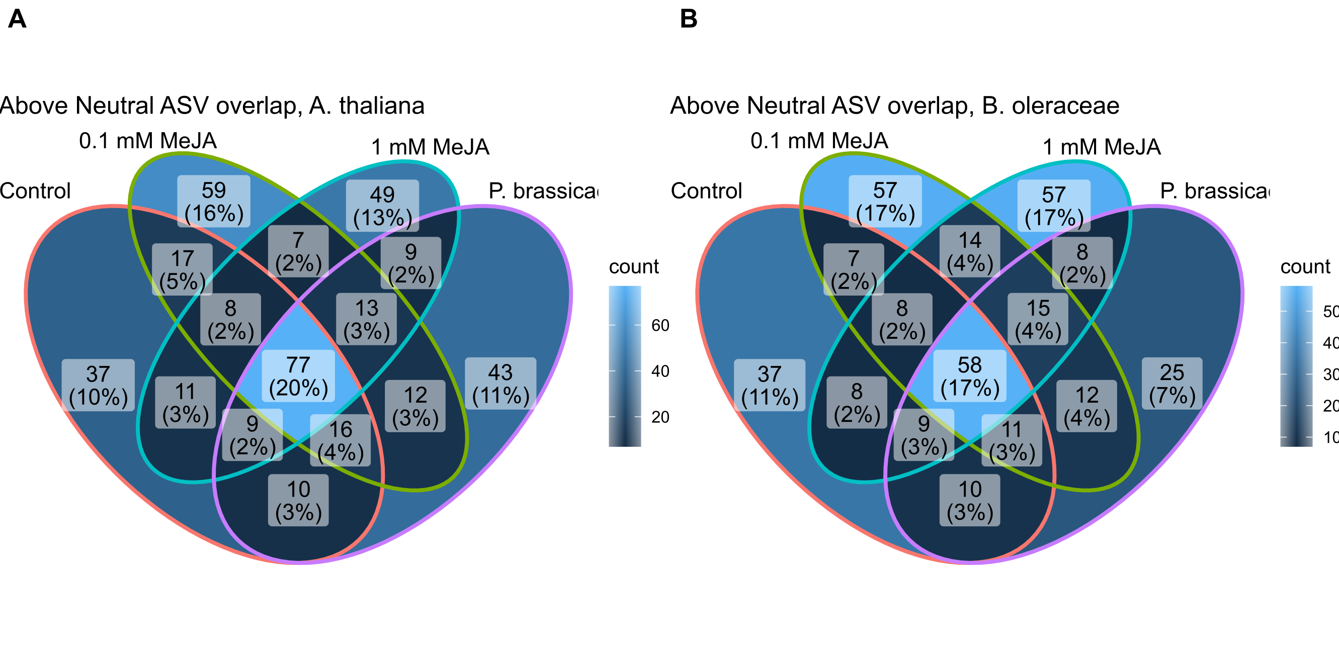
NeutralModel_Veen [MAIN]. Venn diagram indicating overlap of ASVs that were classifiead as above-expected in the neutral model in each treatment for for A. thaliana (A) and B. oleracea (B). The total number of ASVs in each venn section is displayed above the total percentage of ASVs in that section.

Slide 28
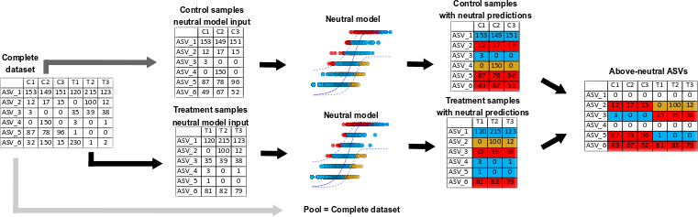
NeutralModels_scheme [SUP]. Scheme demonstrating microbial community data split, neutral classification, filtering and re-joining. The complete dataset refers to all treatment samples in a group of samples, such as rhizosphere of A. thaliana. This data was then partitioned by experimental treatments, and neutral community models are calculated independently for each partition. The complete dataset was used as the metacommunity "pool", used as the source of ASVs in the neutral model. In each neutral model, every ASV is classified as "above-expected" (in red), "as expected" (in blue), or "below-expected" (in yellow), depending on the occupancy-abundance ratio and the migration parameter that is derived from the data. ASVs that were classified as "above-expected" in the neutral model of at least one treatment were kept in a new dataset of above-neutral ASVs. This new dataset was the input for alpha and beta diversity analysis of above-neutral ASVs.

Slide 29
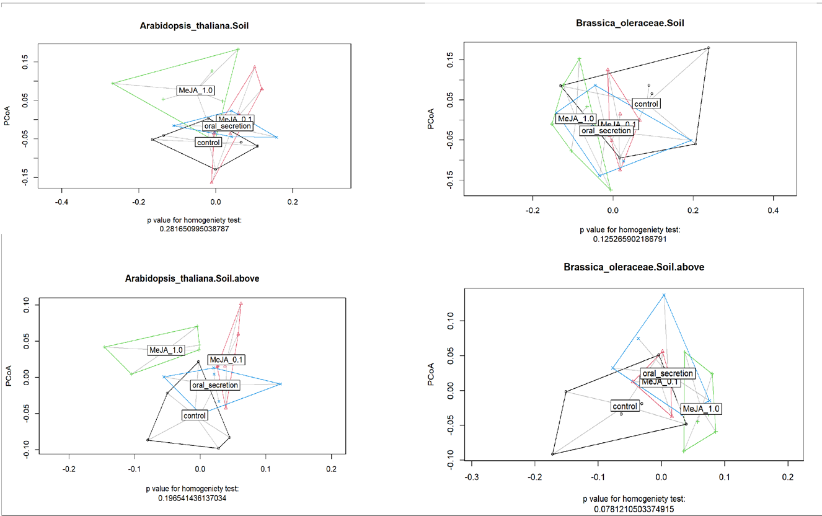
NeutralModel_ordinations_provisory_SUP: rhizosphere communities of A.thaliana and B. oleraceae in the full community and for above-neutral ASVs
This is a very provisory figure we could still discuss if we want to include or not. I had trouble saving the R object and did not export as .svg

Slide 30
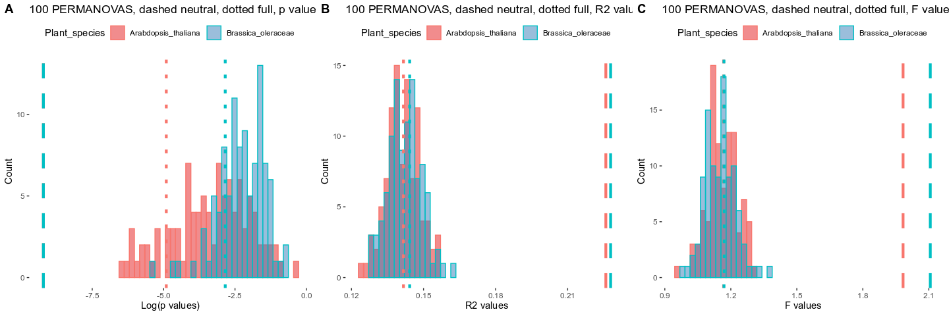
NeutralModel_100_permanovas_histogram: Stress treatment p values (A), R2 values (B), and F values (C) in different PERMANOVAs. Values from the complete dataset are shown in dotted lines, values from the above-neutral ASV subset are shown in dashed lines, and the 100 PERMANOVAs calculated with randomly picked ASVs are shown as histograms. The number of random ASVs picked from each treatment was equal to the number of ASVs classified as above expected by the neutral model in each treatment.

Slide 31
Results
Neutral models
2 tables, PERMANOVA table and pairwise comparisons [2 SUP]
Table_Permanovas_above_neutral: PERMANOVA table of community composition including only the ASVs classified as above-neutral in at least one treatment. SumOfSqs = Sum of Squares, R2 = explained variance, Df = degrees of freedom, asterisks indicate significant differences
Plant species | Sample type | Effect | Df | SumOfSqs | R2 | F value | P value
A. thaliana | Rhizosphere | Stress treatment | 3 | 0.11377 | 0.22789 | 2.1067 | 1.00E-04 | **
 |  | Block | 5 | 0.11544 | 0.23123 | 1.2826 | 1.00E-04 | **
 |  | Residual | 13 | 0.27001 | 0.54087
 |  | Total | 21 | 0.49922 | 1
B. oleracea | Rhizosphere | Stress treatment | 3 | 0.12263 | 0.2259 | 1.9829 | 1.00E-04 | **
 |  | Block | 5 | 0.111 | 0.20448 | 1.0769 | 1.00E-04 | **
 |  | Residual | 14 | 0.30921 | 0.56962
 |  | Total | 22 | 0.54283 | 1
SUP_Pairwise_permanova_table_neutral: Pairwise comparisons of above-neutral microbial sub-community compositions in each data partition (based on adonis.pair function of the EcolUtils R package).
Plant sp.​ | Sample type​ | Pairwise comparison​ |  |  | SumsOfSqs​ | MeanSqs​ | F.Model​ | R2​ | P.value​ | P.value.corrected​
AT​ | Rhizosphere​ | control | <-> | MeJA_0.1 | 0.037789 | 0.037789 | 2.060087 | 0.170819 | 0.003996 | 0.005994006
AT​ | Rhizosphere​ | control | <-> | MeJA_1.0 | 0.042581 | 0.042581 | 1.970279 | 0.164598 | 0.003996 | 0.005994006
AT​ | Rhizosphere​ | control | <-> | oral_secretion | 0.032141 | 0.032141 | 1.633714 | 0.140429 | 0.006993 | 0.006993007
AT​ | Rhizosphere​ | MeJA_0.1 | <-> | MeJA_1.0 | 0.044273 | 0.044273 | 2.346015 | 0.190022 | 0.003996 | 0.005994006
AT​ | Rhizosphere​ | MeJA_0.1 | <-> | oral_secretion | 0.030214 | 0.030214 | 1.784259 | 0.15141 | 0.002997 | 0.005994006
AT​ | Rhizosphere​ | MeJA_1.0 | <-> | oral_secretion | 0.040539 | 0.040539 | 2.006745 | 0.167135 | 0.006993 | 0.006993007
BO​ | Rhizosphere​ | control | <-> | MeJA_0.1 | 0.043274 | 0.043274 | 2.052011 | 0.170263 | 0.002997 | 0.008991009
BO​ | Rhizosphere​ | control | <-> | MeJA_1.0 | 0.058428 | 0.058428 | 2.608005 | 0.206853 | 0.006993 | 0.013986014
BO​ | Rhizosphere​ | control | <-> | oral_secretion | 0.038074 | 0.038074 | 1.49277 | 0.129888 | 0.064935 | 0.064935065
BO​ | Rhizosphere​ | MeJA_0.1 | <-> | MeJA_1.0 | 0.042295 | 0.042295 | 2.56103 | 0.203887 | 0.002997 | 0.008991009
BO​ | Rhizosphere​ | MeJA_0.1 | <-> | oral_secretion | 0.027824 | 0.027824 | 1.418373 | 0.124219 | 0.025974 | 0.038961039
BO​ | Rhizosphere​ | MeJA_1.0 | <-> | oral_secretion | 0.035359 | 0.035359 | 1.689276 | 0.144515 | 0.033966 | 0.040759241

Slide 32
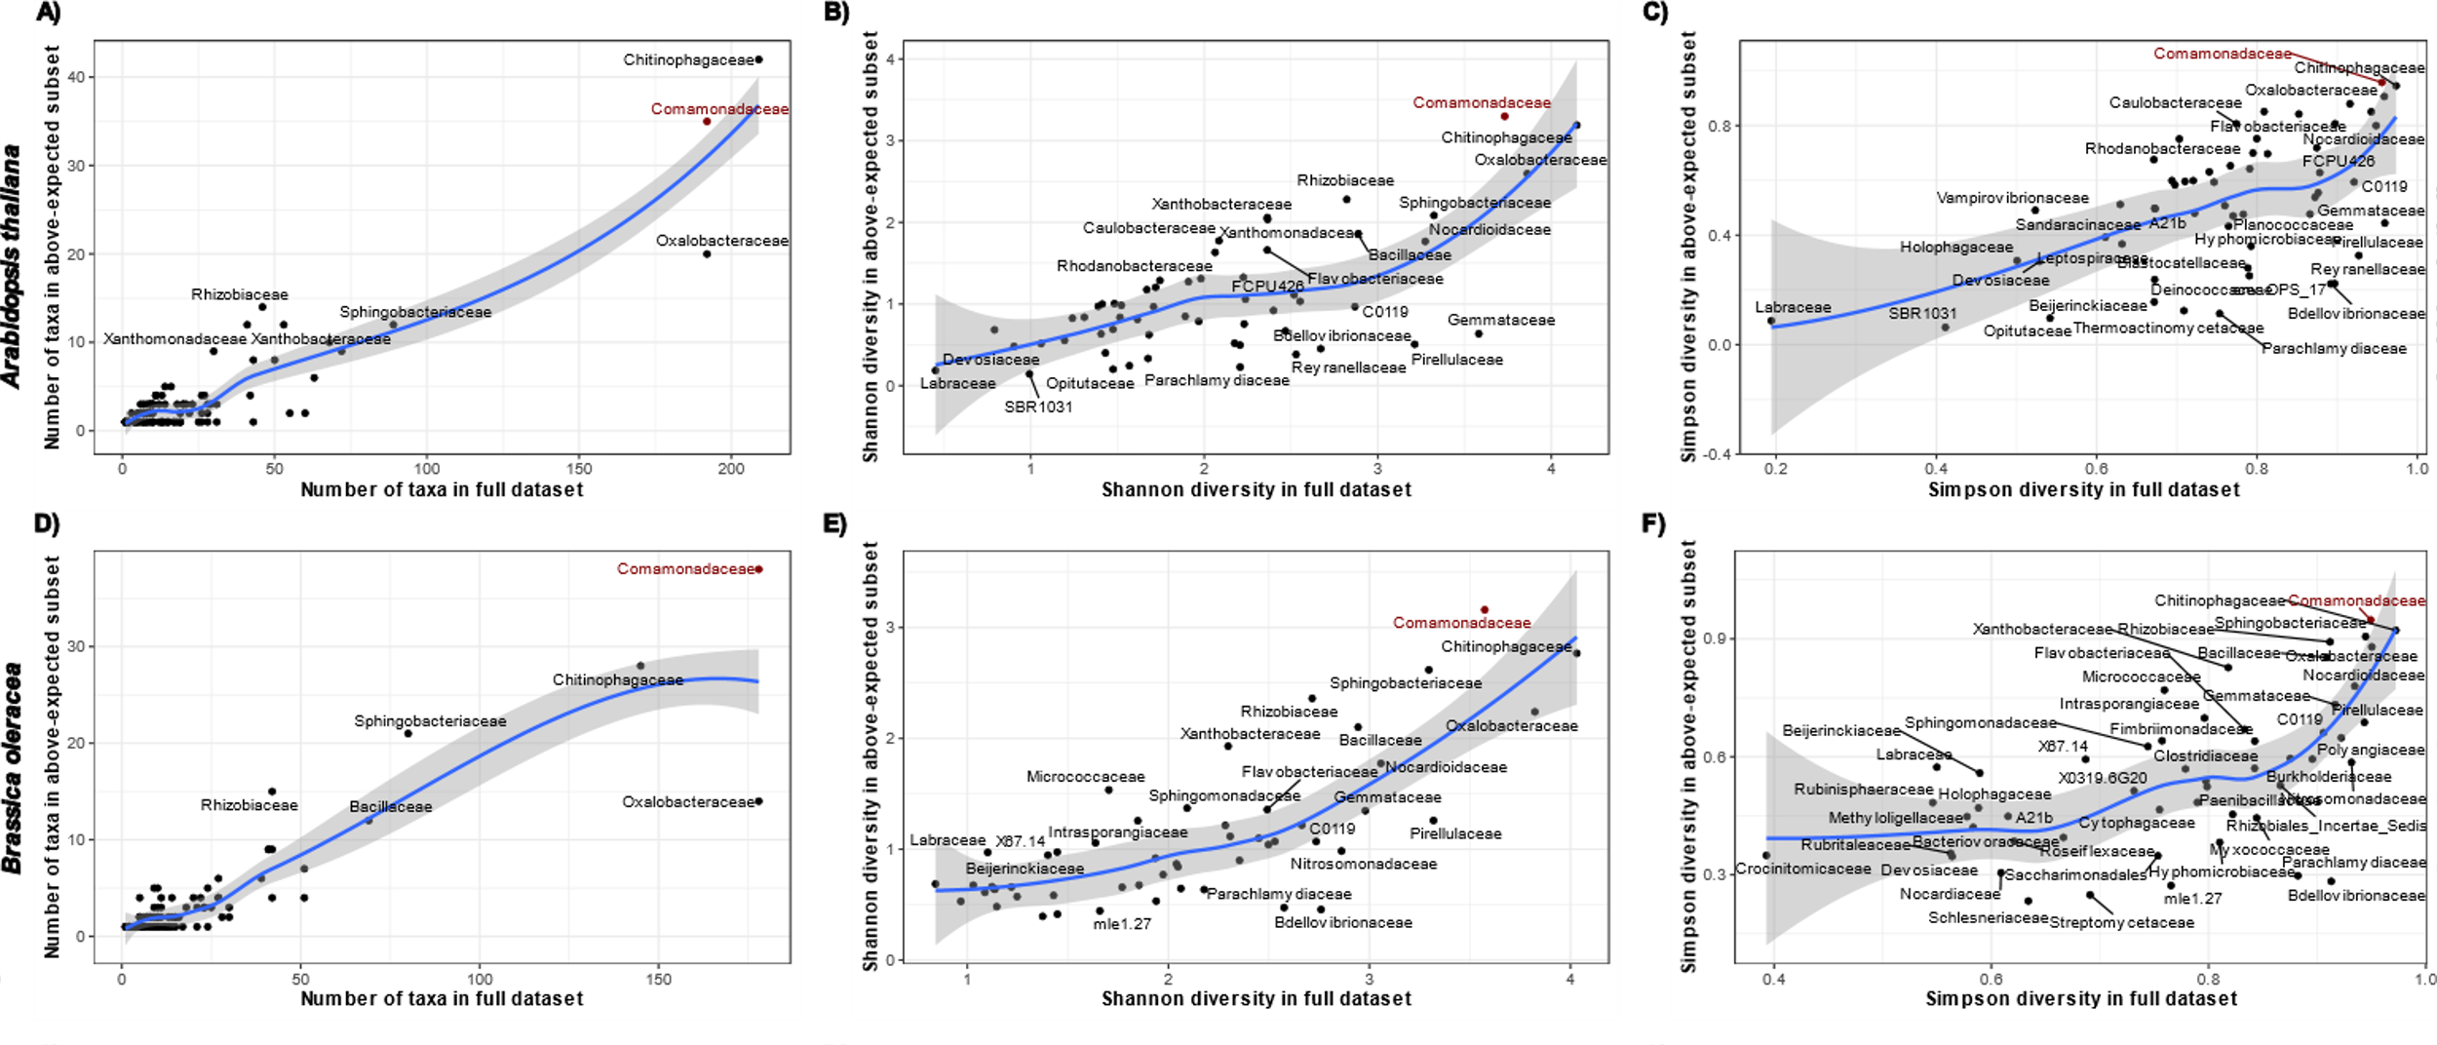
Results
Neutral models
Alpha diversity regression (focus on comamonadaceae)
1 figure with 6 pannels (observed, Shannon and simpson diversity at Family level for BO and AT) [MAIN]
Correlation of alpha diversity indexes between the above-expected subset and the full rhizospherecommunity at Family level. The blue lines indicate a loess regression, and the gray area indicates confidence intervals. Diversity indexes shown are Observed number of taxa (left), Shannon (center), and Simpson (right) in the rhizosphere compartment of A. thaliana (top) and B. oleraceae (bottom). Comamonadaceae family is highlighted in red.

Slide 33
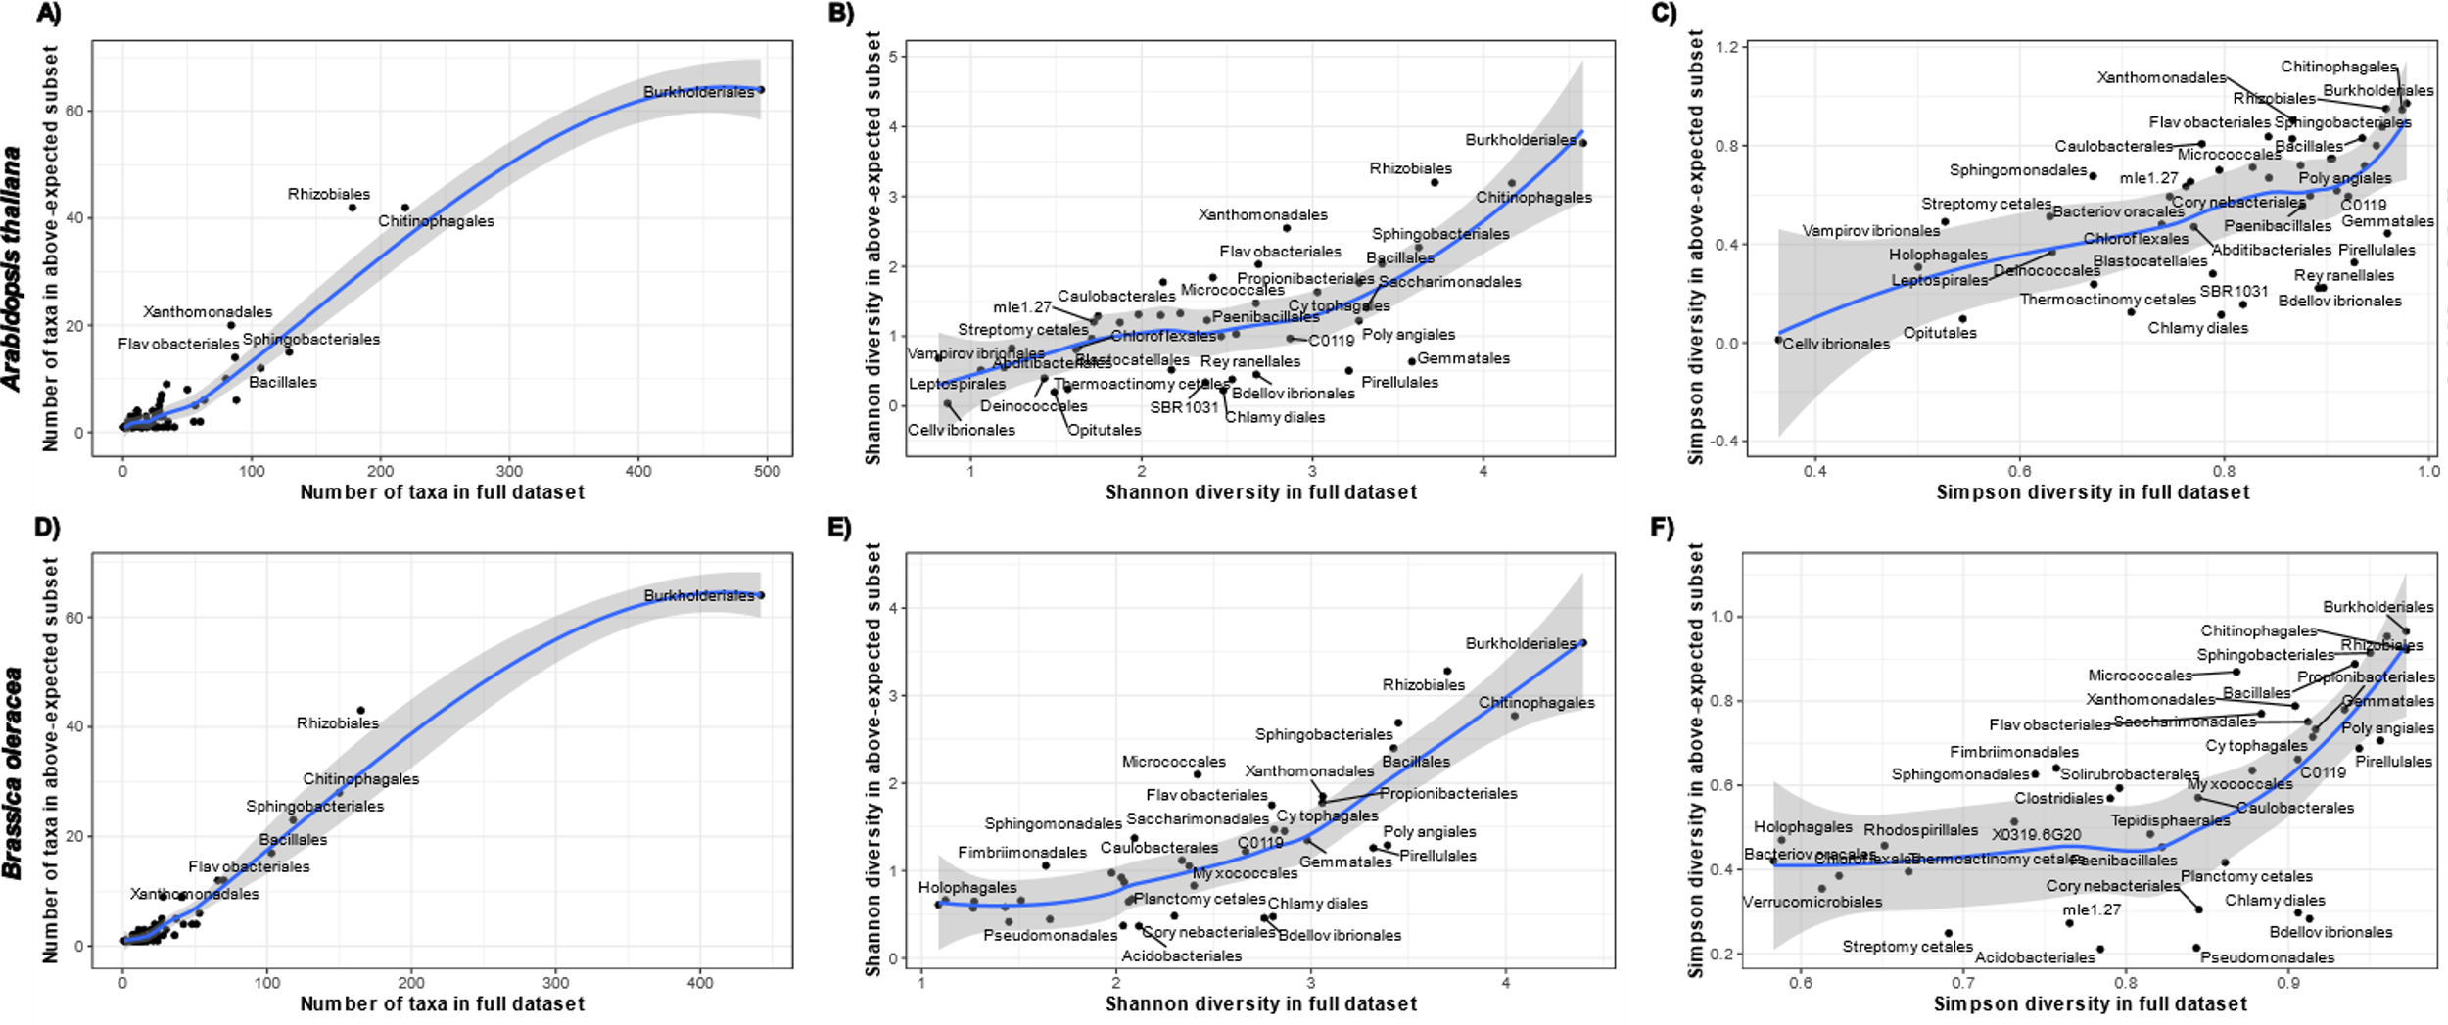
Results
Neutral models
Alpha diversity regression (focus on comamonadaceae)
1 figures with 6 pannels each (observed, Shannon and simpson diversty at Order level for BO and AT) [2 SUP]
Correlation of alpha diversity indexes between the above-expected subset and the full rhizosphere community at Order level. The blue lines indicate a loess regression, and the gray area indicates confidence intervals. Diversity indexes shown are Observed number of taxa (left), Shannon (center), and Simpson (right) in the rhizosphere compartment of A. thaliana (top) and B. oleraceae (bottom).

Slide 34
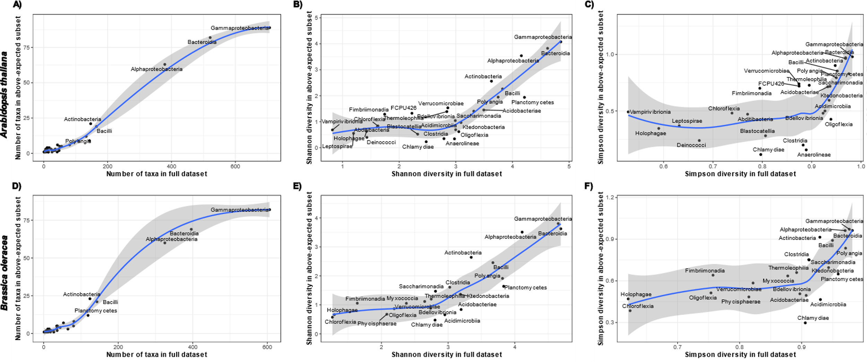
Results
Neutral models
Alpha diversity regression (focus on comamonadaceae)
1 figures with 6 pannels each (observed, Shannon and simpson diversty at Class level for BO and AT) [2 SUP]
Correlation of alpha diversity indexes between the above-expected subset and the full rhizosphere community at Class level. The blue lines indicate a loess regression, and the gray area indicates confidence intervals. Diversity indexes shown are Observed number of taxa (left), Shannon (center), and Simpson (right) in the rhizosphere compartment of A. thaliana (top) and B. oleraceae (bottom).

Slide 35
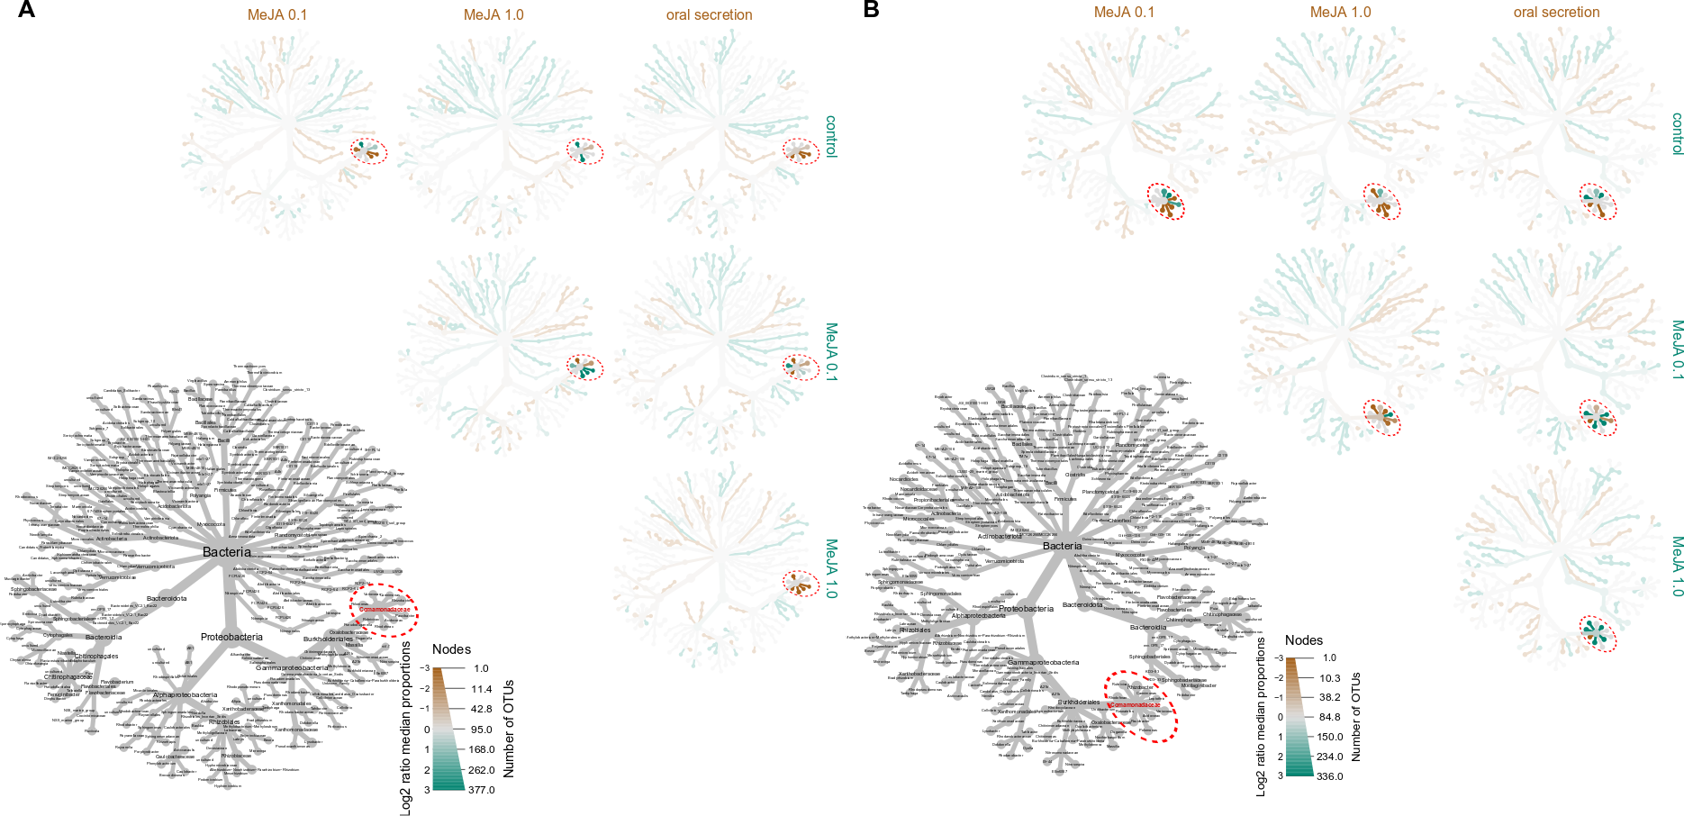
Results
Neutral models
Above-expected differential abudances
1 figure with 2 pannels, has complex matrix of heat trees [MAIN]
Figure X. Differentially abundant ASVs in the above-expected subset. [MAIN]. Matrix of heat trees showing differentially abundant ASVs occurring above expected according to a Neutral Community Model (NCM) for (A) A. thaliana and (B) B oleracea. Branches are colored according to pairwise comparisons; the brown color indicates higher abundance of the ASVs on the treatment indicated by columns, while the teal color indicates higher abundance in the treatments indicated by the rows. The grey tree at the low left panel contains is the legend key of the bacterial taxa in each of the taxonomical ranks. Each tip represents one ASV.
Notes:
Note: Too much to be one figure

Slide 36
Discussion
Methyl Jasmonate triggers plant defense
Validate Experimental approach
(plenty of references already use MeJA to stress plants, we don’t need to give much attention)
MeJA impacts the microbial community similarly to Oral Secretion, thus MeJA can be used in place of real insects
(there are “ifs” and “buts” here, so we don’t really have definitive evidence on this. The real evidence is that the plant is stressed)
Show methodological variation on MeJA applications (foliar spray and sealed chamber)
(our method provides a better entry of MeJA to the plant than foliar spray, but it is less arguably less work & resource intensive than release in a sealed chamber. We also better avoid direct contact of MeJA with soil)

Slide 37
Discussion
Stress treatments were subtle on the structure of the full community but clear on the taxa occuring above neutraility
Compare base alpha and beta diversity to other references
(other references only use the basic analysis methods on roots and soils but do not highlight comamonadaceae,.they also only test a single plant species on every report, no use of neutral models, network or random forest)
Advantages Methodological approach on neutral models
(a model-based selection of ASVs that can be further analyzed, has clear definitions and is easely reproducible)
the neutral splitting-and-joining can help see subtle treatment effects ;
(turns sublte treatment effects into very clear community differences – it helps in finding the differences that matter to treatments without directly looking at differences in ASV abudance between treatments)
the neutral tree can help locate a diversity hotspot (mention rhizobiales but limit discussion)
(Modern visualization allows us to screen all phylogenetic levels and their relationships, pinponting key drivers for differences and similarities between treatments)

Slide 38
Discussion
“Fishing” with Fisher: 1 out of 1.111 taxa highlighted by 3 different methods
Show how the excess of information complicates analysis
(Adress complexity of microbiomes and their analysis methods)
Show that after using several methods we still have a complex dataset
(even on a small subset of 346 ASVs, we have several different classifications, imporance tags, and 4 distinct base datasets)
the fisher test in a heat tree helps summarizing findings (approach to data deluge)
(checks against the proper context to the subset of ASVs, evaluating and displaying all taxonomic levels)
(can be used on any list of relevant/irrelevant ASVs)

Slide 39
Discussion
Family Commonadaceae was relevant across treatments, plant species, sample types, and analysis methods
show that comamonadaceae was highlighted independently in both approaches
(this is very valuable: there are no “ifs” and “buts” on the relevance of comamonadaceae; both methods used the same dataset but were independent! Our analysis has consistency and taxonomic resolution!)
Show how common they are on the roots
(literature refereces)
Show how common they are in the insect gut
(literature refereces)
Fit them in the holobiont approach (insects do more than giving a ride to Bac), poiting the similarity to Enterobacter
(enterobacter is well known to inhabit both plants and mammal guts. Comamonadaceae are doing the same thing, but for insects)
We must be careful with this because we have not screened any insect, much less an insect microbiome!
CONCLUSION:
Comamonadaceae are important in insect-plant interactions.
This is far more n depth than defining that proteobacteria are impotnat players in plants
Next studies need strain-level resolution, function definitions, and also insect microbiome screening

Slide 40
Fish out and organize information from Manucritp_draft_Pedro-HP: From Discussion onwards
Introduction we leave at the end
Visual summary
Slide 67 onwards
Analysis_flowchart → inkscape → make shorter (at the end)
Look for code for figures of plant biomass:
Fix picture → look for close-up pictures of necrotic wound

Slide 41
Pedro’s to-do list
Fix picture → look for close-up pictures of necrotic wound
Upload raw data for qPCR and code of the figure
Review in literature necrotic spot, what is it?

Slide 42
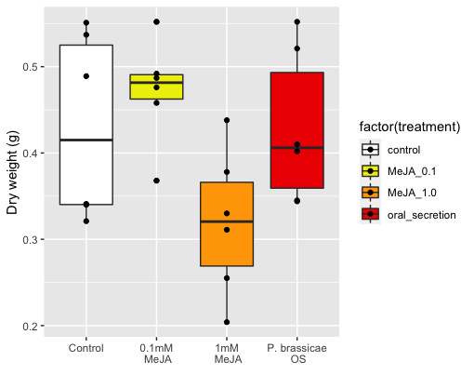
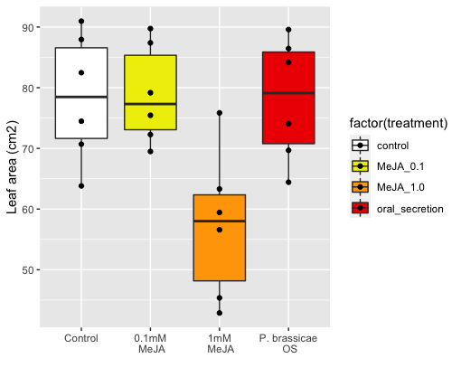
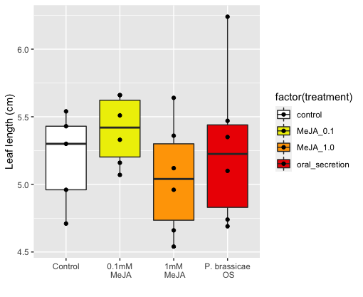
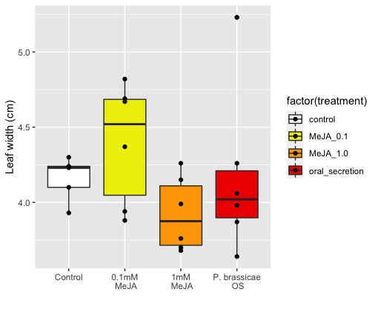
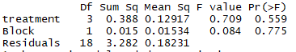
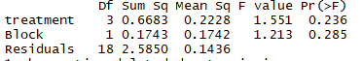
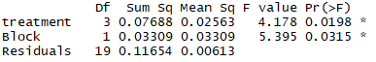
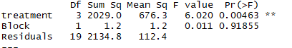
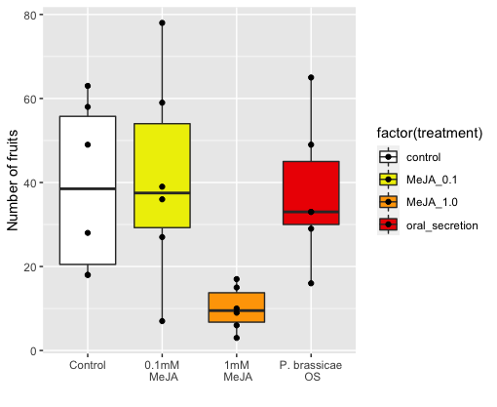
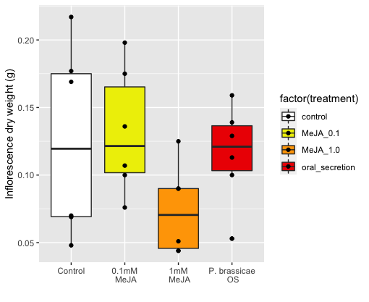
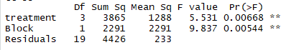
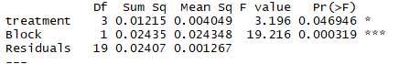
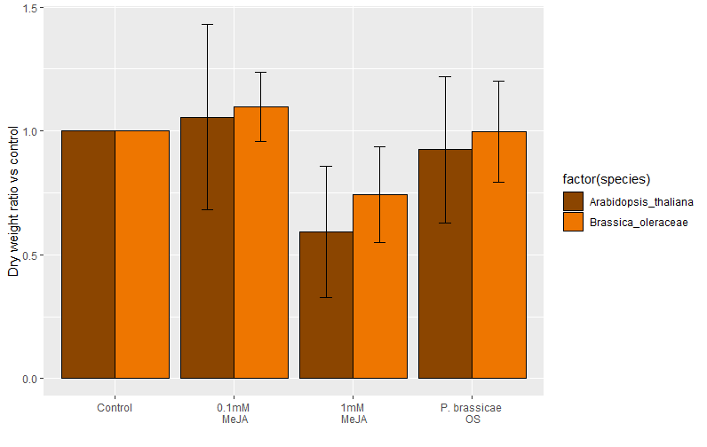
a)
b)
c)
d)
e)
f)
g)
Cohen's d
d estimate: -0.008485888 (negligible)
95 percent confidence interval:
lower upper
-1.294908 1.277936
figure_plant_phenotype: measured plant traits from brassica oleraceae (a-d) and Arabidopsis thaliana (e-f). Cohen’s D (g) shows dry weight fold comparisons to respective controls;
Cohen's d
d estimate: 0.4871191 (small)
95 percent confidence interval:
lower upper
-0.818236 1.792474
Cohen's d
d estimate: -1.148179 (large)
95 percent confidence interval:
lower upper
-2.5365490 0.2401916
MeJA is reducing plant biomass
Compared to their controls both species show the same effect (even though magnitude is different)
Figure 1: g) done properly, a-f figures in supplementary
Cohen’s D paper Use of cohens D to compare multiple experiments/controls: https://nph.onlinelibrary.wiley.com/doi/full/10.1111/nph.15504

Slide 43
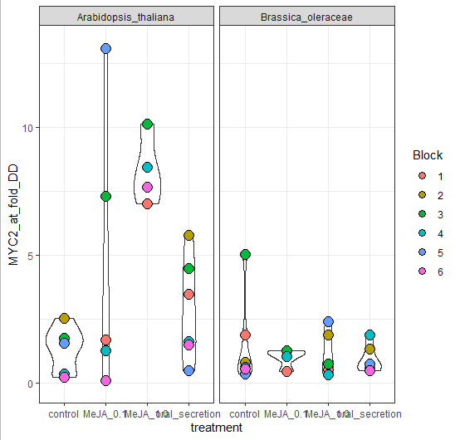
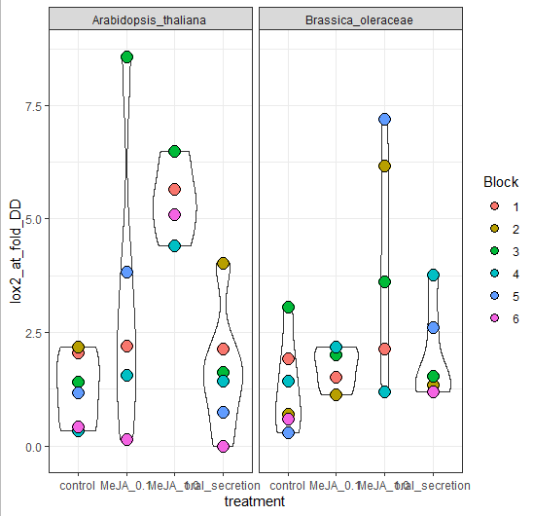
Point for discussion: Do we really want to include this plots?
figure_qPCR: leaf expression of MYC2 (a) and Lox2(b), 3h after the final hormone dipping event and 2 days before harvesting
There’s higher MYC2 and LOX2 expression in MeJA 1% but only in Arabidopsis thaliana
However, no difference in Brassica oleracea
Fix figure with bar plots or gene-expression standard plots, → Supplementary (IF ever included)
Add stats to plot

Slide 44
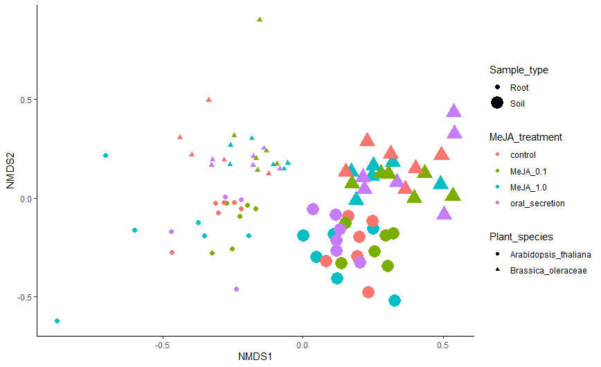
CCS normalization
R script: 2_Beta_diversity
Code chunk: 2.1 - Beta Diversity plots
Stress: 0.1521784 (ok)
Figure 1.
There is a clear effect of root and soil as expected
There is a clear species effect as expected
Treatment effects are not visible
Resonining behind why splitting in 4 the analysis afterwards
+ PERMANOVA RESULTS OVERALL FOR ALL SAMPLES
Figure_Beta_diversity_all_samples : NMDS plot showing clear clustering by plant species and sample types, and mixed treatment effects
Make it pretty
Change labels: Endosphere and Rhizosphere

Slide 45
To make tables for each data partitions with permanova result + pairwise comparisons
Significant treatment effect in all but in Bo-Rhizosphere
There is a significant effect of MeJA for both At and Bo for the endosphere community
PERMANOVA RESULTS OF BETA DIVERSITY – PARTITIONED IN 4
Bo-Endo
Bo-Rhizo
At-Endo
At-Rhizo
+PAIRWISE COMPARISONS
Bo-Endo
Bo-Rhizo
At-Endo
At-Rhizo
Figure 1/Table 1
There is a clear effect of root and soil as expected
There is a clear species effect as expected
Treatment effects are not visible
Resonining behind why splitting in 4 the analysis afterwards

Slide 46
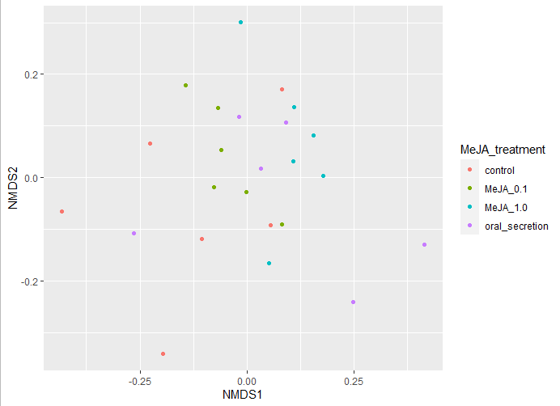
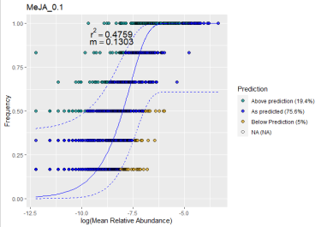
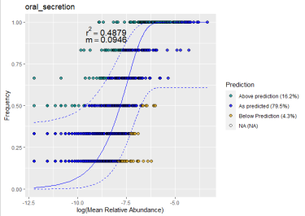
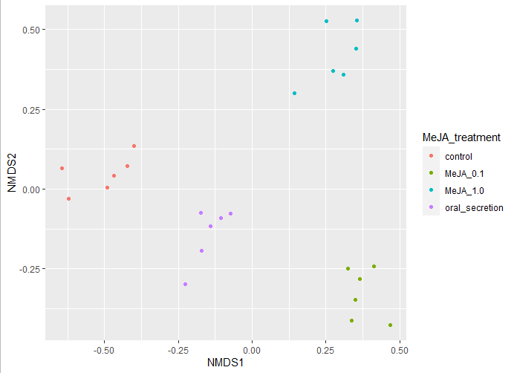
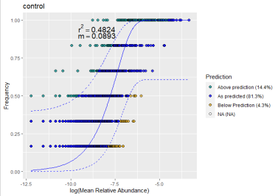
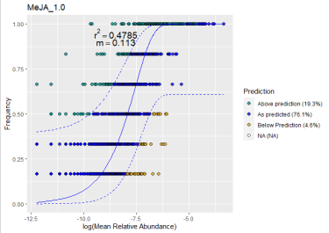

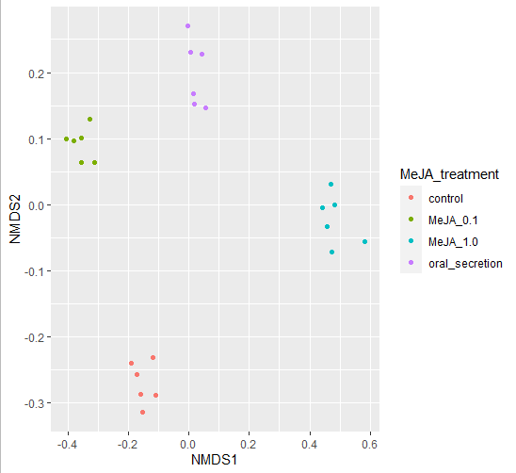
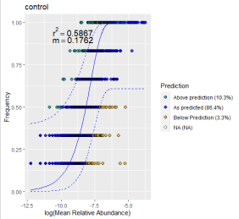
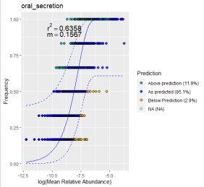
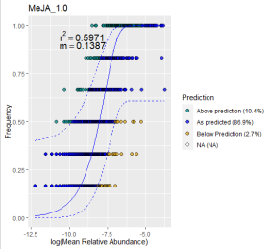
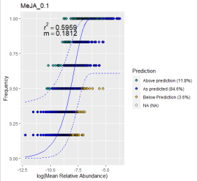
Figure 2. NM fit of rhizosphere samples for both AT and BO.
16S communities not neutrally assembled (<R2)
Once above-expected communities are selected and ordinated it’s clear that they are different and that there is an effect of the treatment p<0.001
For AT, difference between control and treatments are explained by NMDS2
For Bo, there is not a clear split
NMDS Stress = 0.0850
MeJA effect p = 0.001
MeJA effect R2 = 0.63
Stress = 0.065
R² = 0.72
P = 0.001
A): Ordinated by Beta Diversity, B) neutral model fit for partitions C) Ordination with Above expected.
Having a clear conclusion for both species

Slide 47
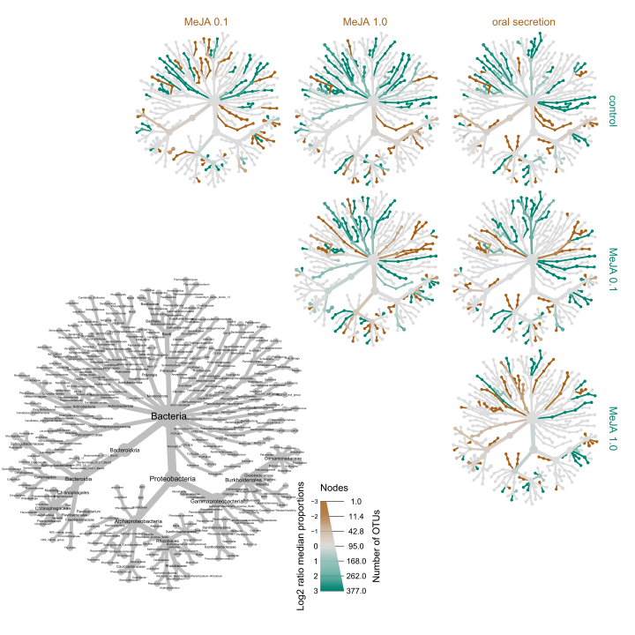

A)
B)
Fig. 3
Neutral_heat_trees: Matrix of heat trees showing differential abundance of ASVs occurring above the expected tresholds in a neutral model for A. thaliana (A) and B oleracea (B). The grey tree serves as a legend for labels. The brown color indicates higher abundance of the ASVs of the treatment indicated by columns, while the teal color indicates higher abundance in the treatments indicated by the rows

Slide 48


Fig. 4. Alpha correlation Shannon –
Only Family (maybe)
Order for supplementary + other diversity index
figure_alpha_correlation_shannon: Correlation between the Shannon diversity in the neutraly-selected subset with the full dataset, for Class (left), Order (center), and Family (right) in A. thaliana (top) and B. oleraceae (bottom)
(MAYBE WE SHOULD SHOW RESIDUALS TO THE FIT??)
Notes:
Overall alpha-diversity goes in supplementary
+Differential abundance in supplementary

Slide 49




AT_root
AT_soil
BO_root
Fig. 5. Heat tree
BO_soil
Fisher_test_relevance: Heat trees of all ASVs tagged as 1) important in the Random Forest analysis with Boruta; 2) keystone taxa, module hub or module connector in the network analysis with SpiecEasi ; or 3) differentially abundant in treatment-control comparisons in the differential abundant analysis with deseq2. These form the relevant ASV set for each sample parition. Node and branch colours indicate adjusted p values of a fisher test that compares the proportion of a taxa in the relevant ASV set against the same taxa in the rest of the ASVs. Node size shows the odds ratio of the same test. All p values above 0.15 are colored grey.

Slide 50
Diversity and Abundance of Full data
Above expected by NMs
Diversity and Abundance
in important ASVs (heat-trees)
Fig. 6. Validation/Here we show the importance of the pipeline to highlight important ASVs focused on these 2 families
Stats missing per family
Figure_alpha_diversity_above_expected: Shannon diversity index for taxa higlighted as above expected in the neutral models

Slide 51

Figure_rarefaction: rarefaction curve for filtered (min 8 occurences) ASVs. Curved black lines represent root samples. Curved red lines represent soil samples. The dashed red line shows the minimum library size
Supp 1: Minimum library size of the smallest library had about 8,000 reads, proof of rarefaction

Slide 52

Results
Plant growth & qPCR (show plants were stressed)
1 figure, Cohen’s D effect size across species and variables [MAIN]
Cohen’s D to standardize plant responses based on controls and variation across replicates.
Calculated as the difference between experimental and control means divided by their pooled SD.
Positive or negative values indicate that the treatment values are larger or smaller than those in the control, respectively (Need to change this)
Figure X. Forest plot of the effect size of traits measured for (A) A. thaliana and (B) B. oleracea in stress treatments compared to controls [SUP or MAIN?]. Black dot shows Cohen’s D value and bars show the 95% confidence interval. Red dashed-line indicates a value of 0.5, above which the effect size is considered large (Cohen et al., XXXX). Negative Cohen’s D values indicate that the trait measurement had higher values in stress-induced plants compared to controls, whereas positive values indicate that trait measurement values on stress-induced plants were lower than for controls.

